Slide 1

Suicide Prevention & Mental Wellness
at Community Colleges

Slide 2
Ohio House Bill 28 (HB 28)
In 2015, House Bill 28 (Anielski, R-Walton Hills, OH) was signed into law, requiring public higher education institutions to develop and implement a policy to advise students and staff on suicide prevention programs.
  Ohio higher education public institutions are required to:
  Provide students access to crisis intervention
  Engage in mental health programming
  Use multimedia platforms to connect students to resources
  Have a Postvention Plan for incidents impacting the campus/ college community

Slide 3
Why is this important?
An estimated 26% of Americans ages 18 and older – about 1 in 4 adults - live with a diagnosable mental health disorder in a given year.
Nearly ¾ of people with anxiety disorders will have their first episode by age 21.
Young adults aged 18-24 have the highest prevalence of diagnosable forms of mental illness among the entire population, at 27%.
Compared to older adults, the 18-24 yr old age group shows the lowest rate of help-seeking behaviors.
Suicide is the 2nd leading cause of death among college students, claiming the lives of 1,100 students each year.
www.activeminds.org

Slide 4
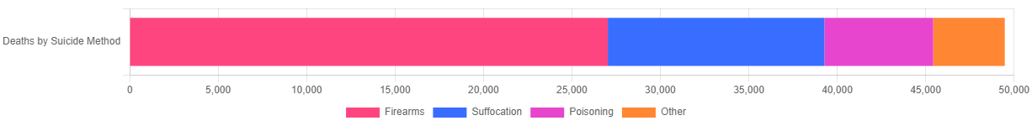
Statistics (national)
In 2022, 49,476 Americans died by suicide.
In 2022, there were an estimated 1,600,000 suicide attempts.
Men die almost 4 times more often than women (3.85).
White males accounted for 7 of 10 suicides in 2022 (68.46%).
In 2022, firearms accounted for 54.64% of all suicide deaths.
www.afsp.org

Slide 5
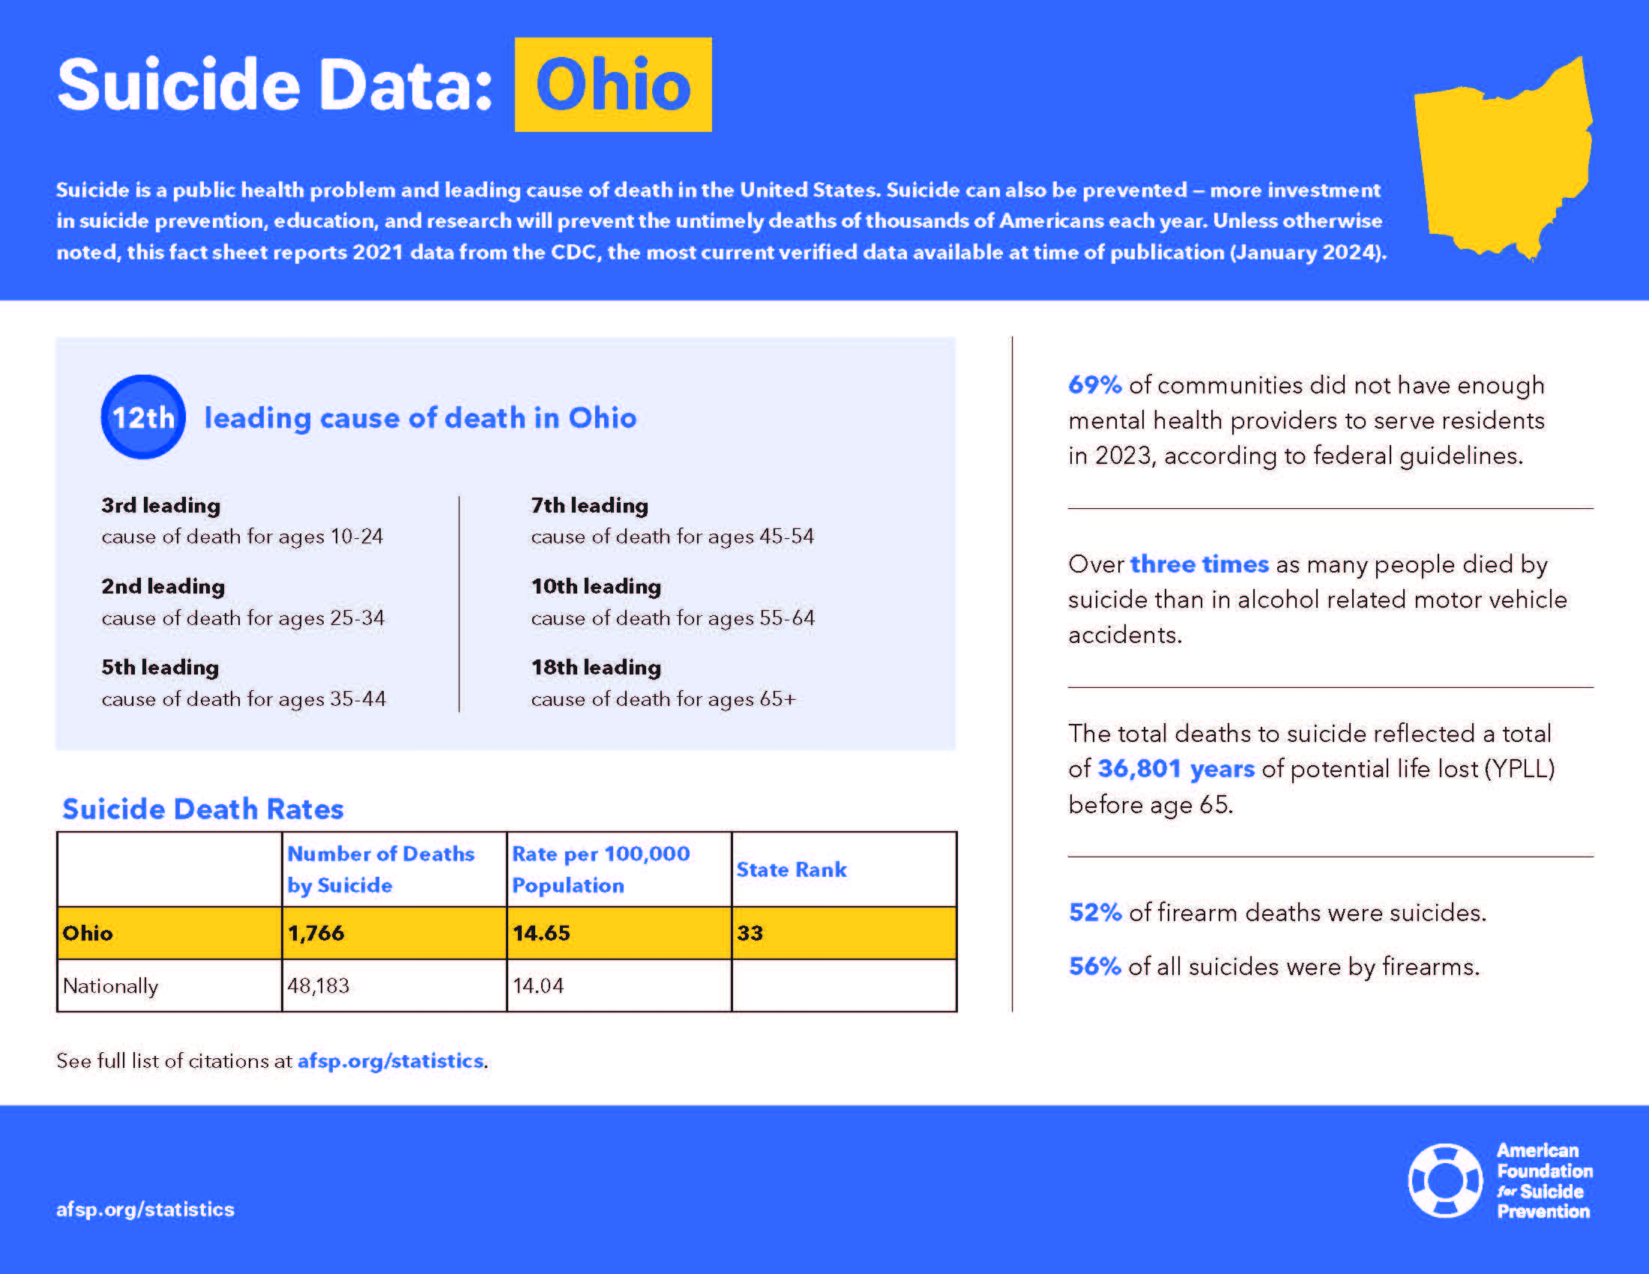
https://afsp.org/state-fact-sheets/

Slide 6

Community College Populations at Risk
Males
International students
LGBTQIA+
Students with pre-existing mental health disorders
Returning military/veterans

Slide 7
A Strength-Based Approach on Campus
Language
Focus on innate strengths
Language and thoughts influence perceptions
Model healthy language
  Died by suicide, not “committed suicide”
  Mental health challenge, not “problem”
  Use mental “wellness” when appropriate
  Refrain from using “crazy” or “insane”, etc.
  Use first-person language
Behavior/Resources
Encourage help-seeking behaviors
Promote counseling services
Be visible on campus
Promote community resources
Promote outreach events
Advocate for internal reporting system
Open (and easy) communication
Prevention, intervention, and postvention plans
Crisis plan
Robust counseling website
Use modern technology

Slide 8

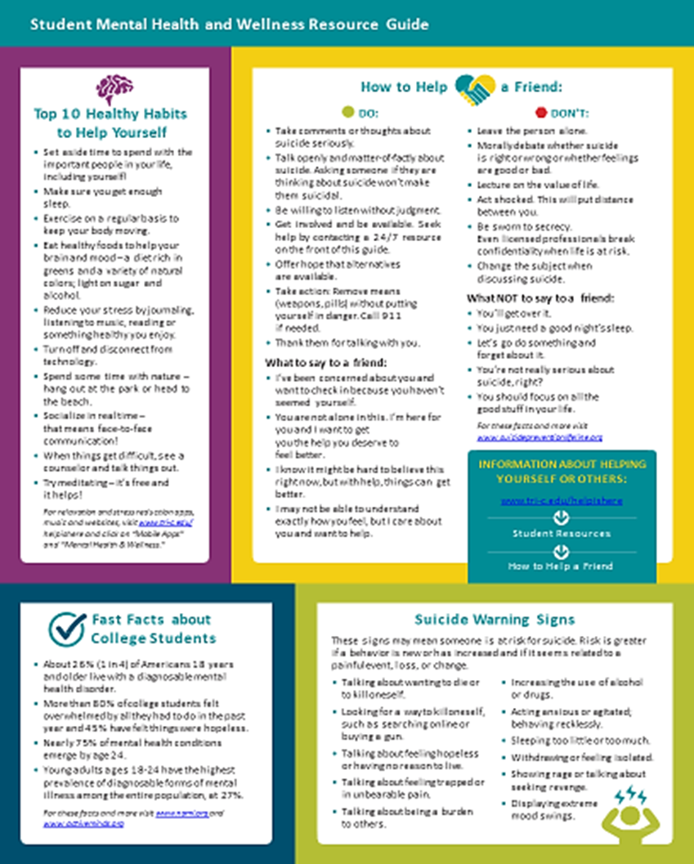

Slide 9
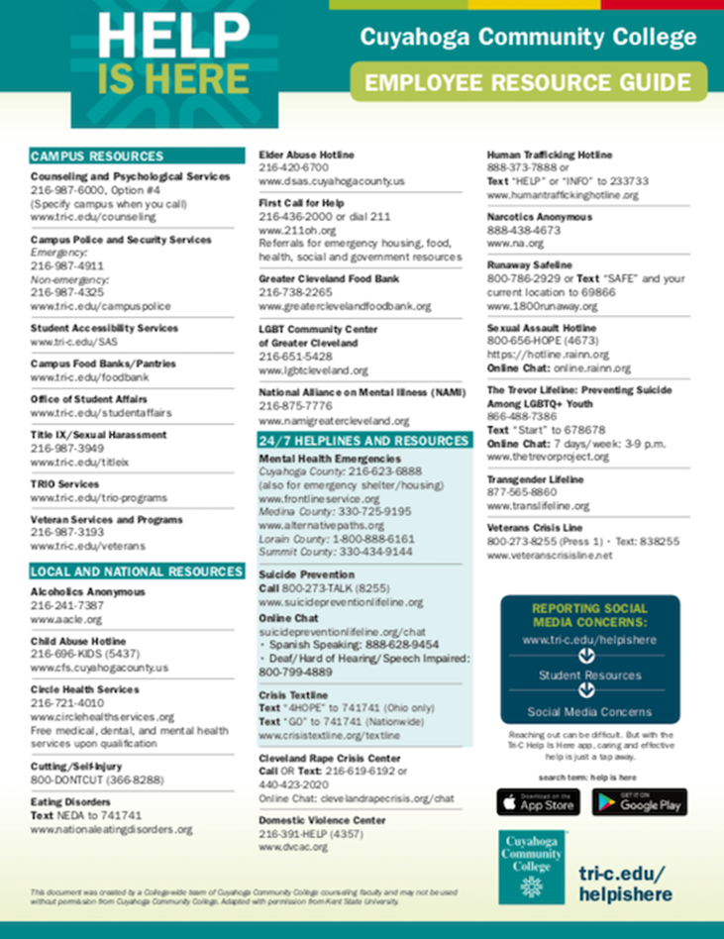
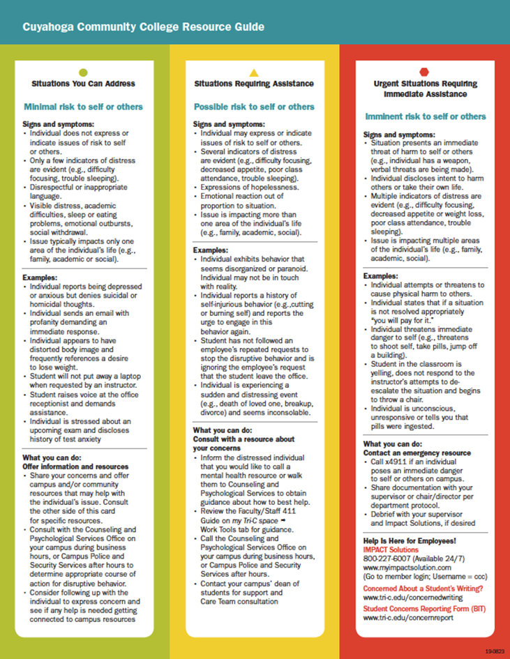

Slide 10

Roll out of 988
College-wide initiative
Buy-in from campus presidents
Buy-in from college leadership
Mass communication with students, faculty, & staff
Focus on high stress areas
  Veterans Services
  Public Safety programs
  International students
  Health career programs
  Student Life organizations
https://988lifeline.org/

Slide 11



Website
For information / quick info / browsing

Slide 12
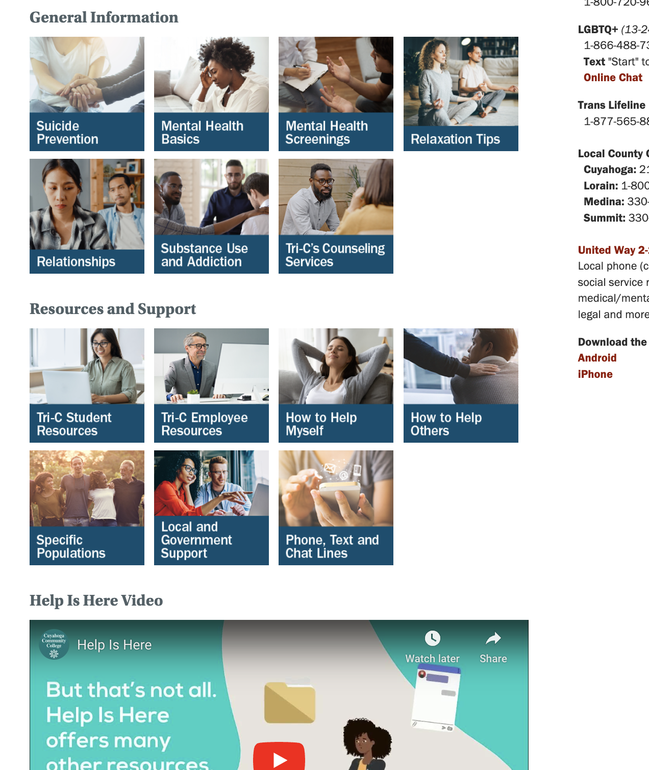

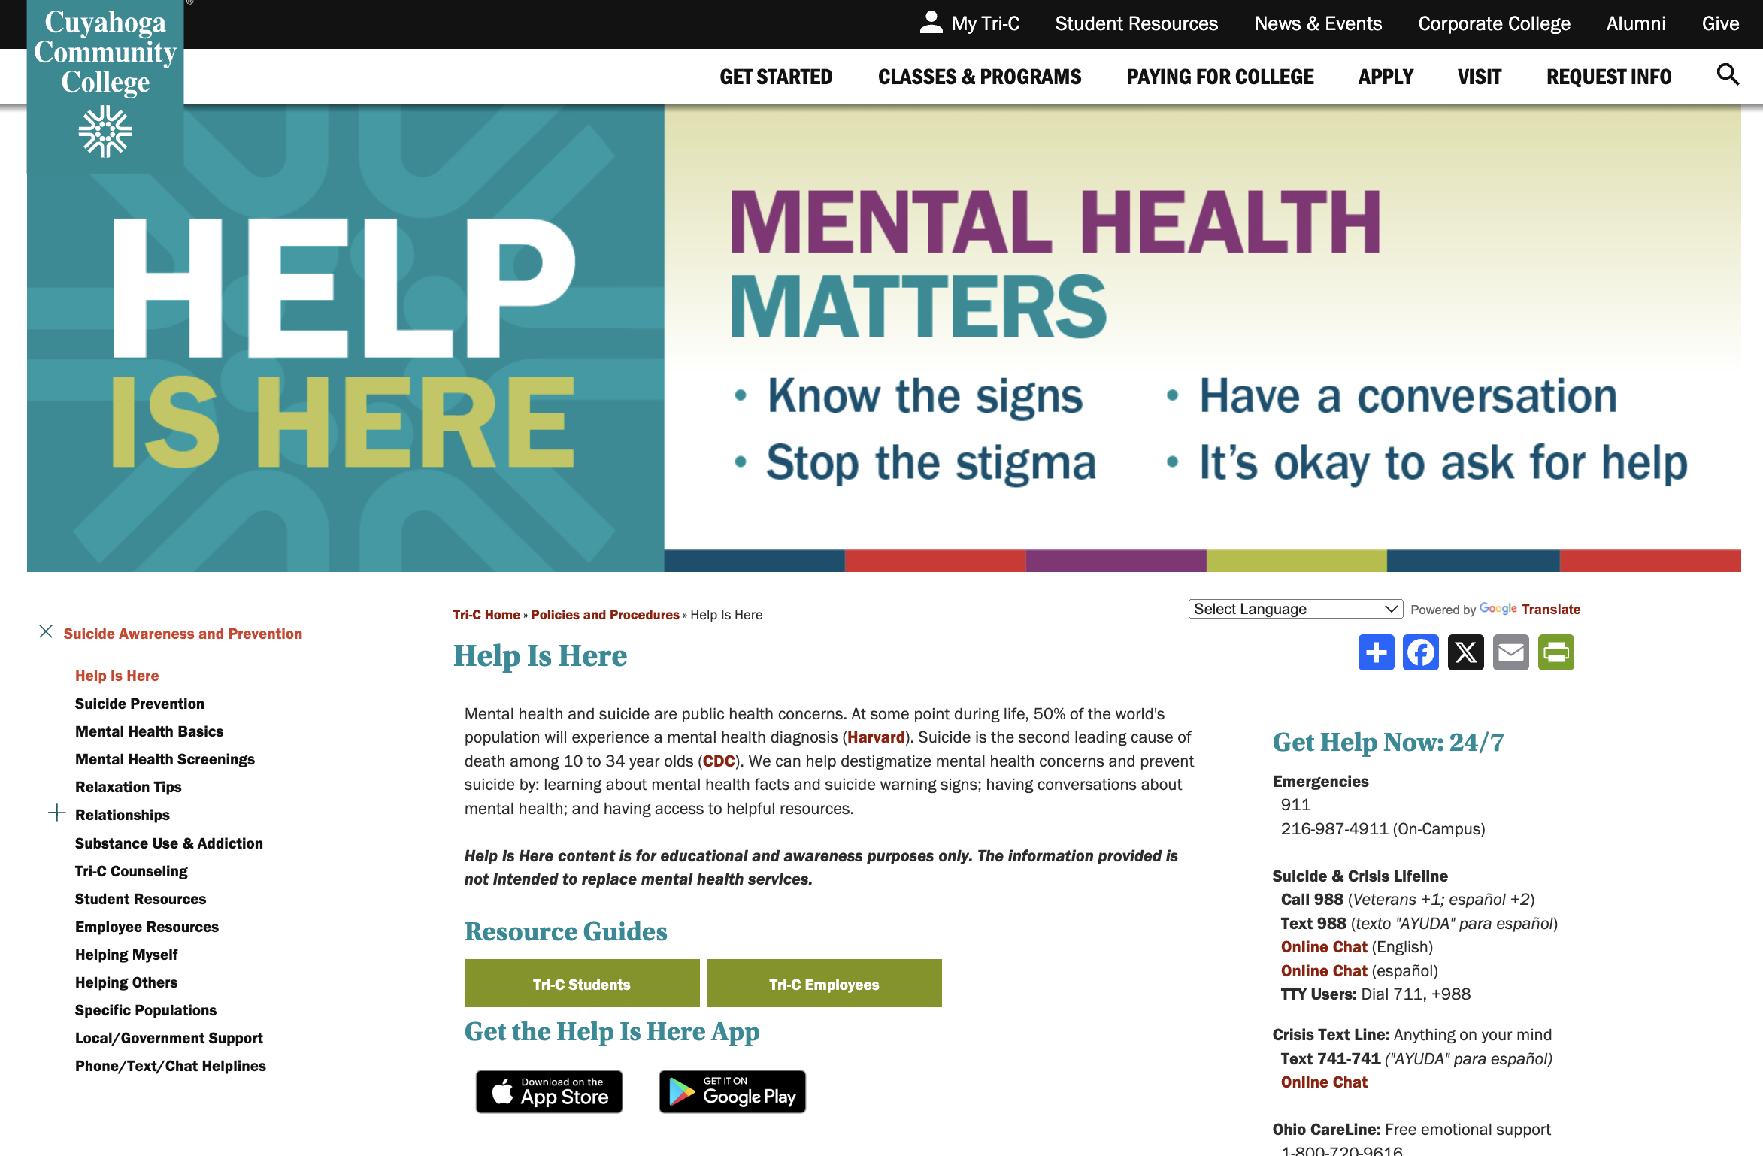
Kevin Berg, PhD, MA, MSW, LSW
Associate Professor, Counselor
Kevin Kuntz, EdS, LPCC-S, NCC
Professor, Counselor
David Nardecchia, MEd, LPCC
Assistant Professor, Counselor
Michelle Nicopolis, PhD, LPCC, Licensed Psychologist
Professor, Psychology

Slide 13
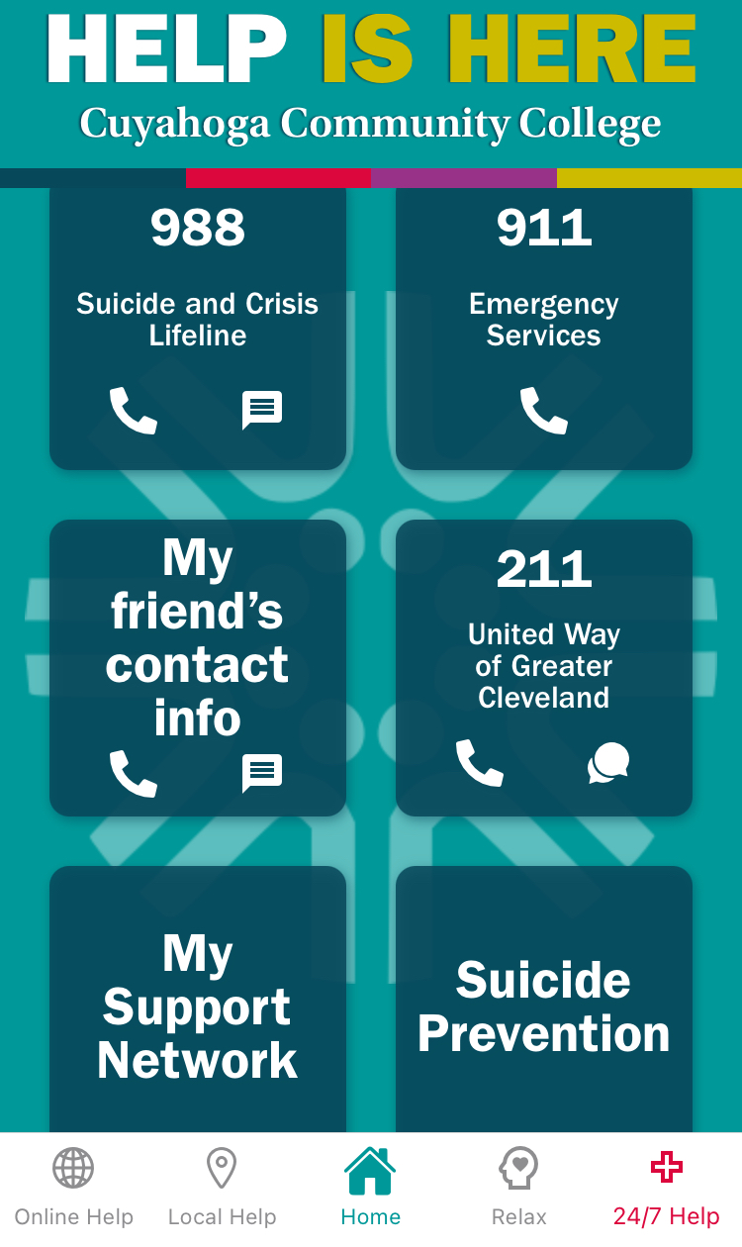

Mobile App
For emergencies / quick info

Slide 14
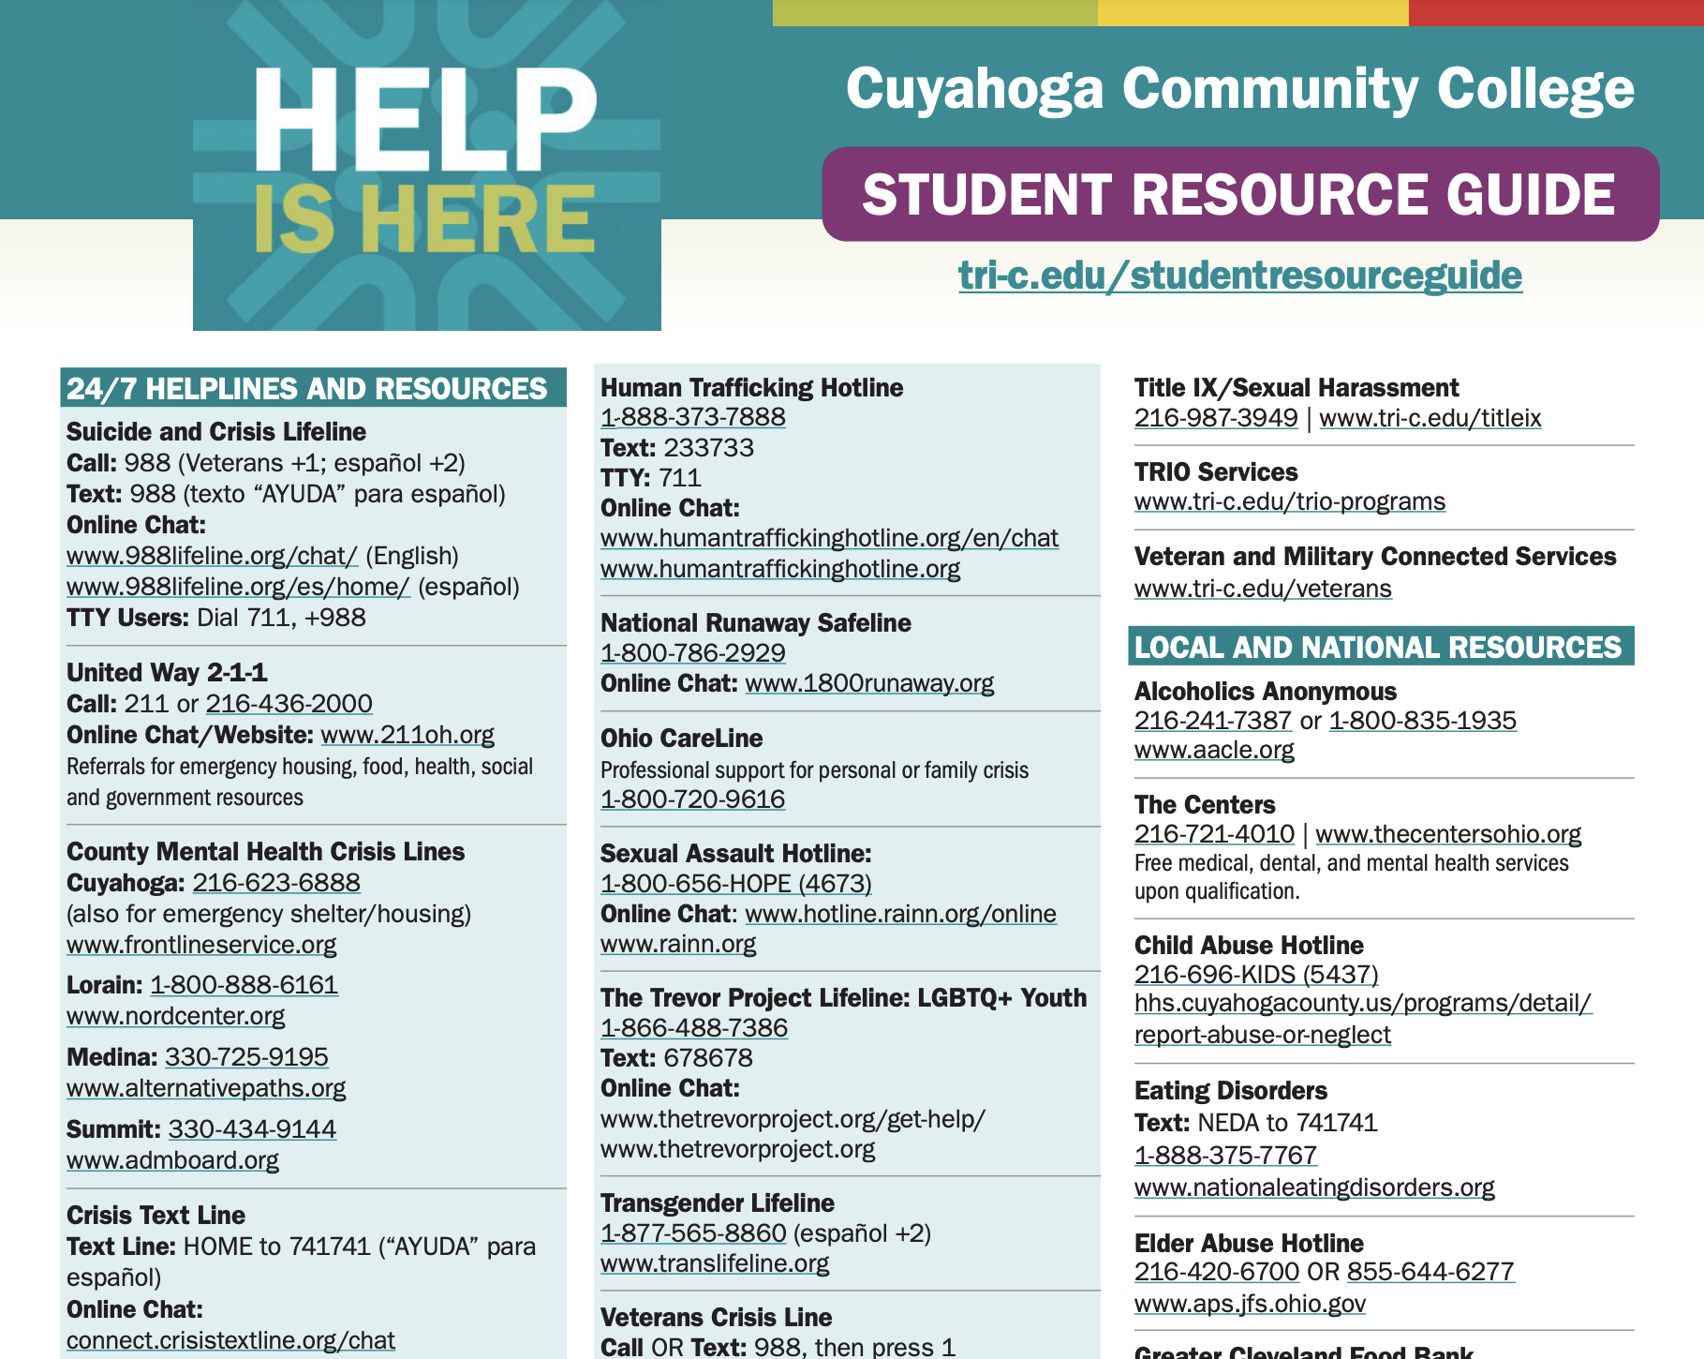

Resource Guide
For quick contact info / how to handle & report situations
tri-c.edu/studentresourceguide

Slide 15
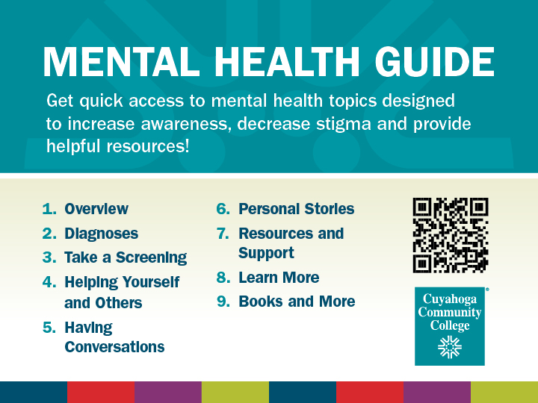

Mental Health Guide
Focuses on specific diagnoses and ways to get / give help
libguides.tri-c.edu/mentalhealth

Slide 16

Ohio Department of Higher Education (ODHE) Mental Health Support Funding Grant
Awarded $360k
2024 – 2025 academic year
Increase help-seeking behavior
Reduce stigma around mental health and wellness issues
Upgrade & redevelop HIH mobile app
Implement an aggressive information and education campaign
Improve awareness and access to resources
https://www.tri-c.edu/news-and-events/news/tri-c-receives-360k-grant-for-mental-health-services.html

Slide 17


Ohio Department of Higher Education (ODHE) Mental Health Support Funding Grant
Objective 1:
Increase help-seeking behavior
Reduce stigma around mental health and wellness issues
Students
Campus & Online Events
Peer-to-Peer

Slide 18

Ohio Department of Higher Education (ODHE) Mental Health Support Funding Grant
Objective 2:
Upgrade & redevelop HIH mobile app
  Cleveland Codes
  School of Advanced Manufacturing, Engineering and Computer Science
  Help Is Here team
  Active Minds
  Psychology Club
  Psychology students

Slide 19
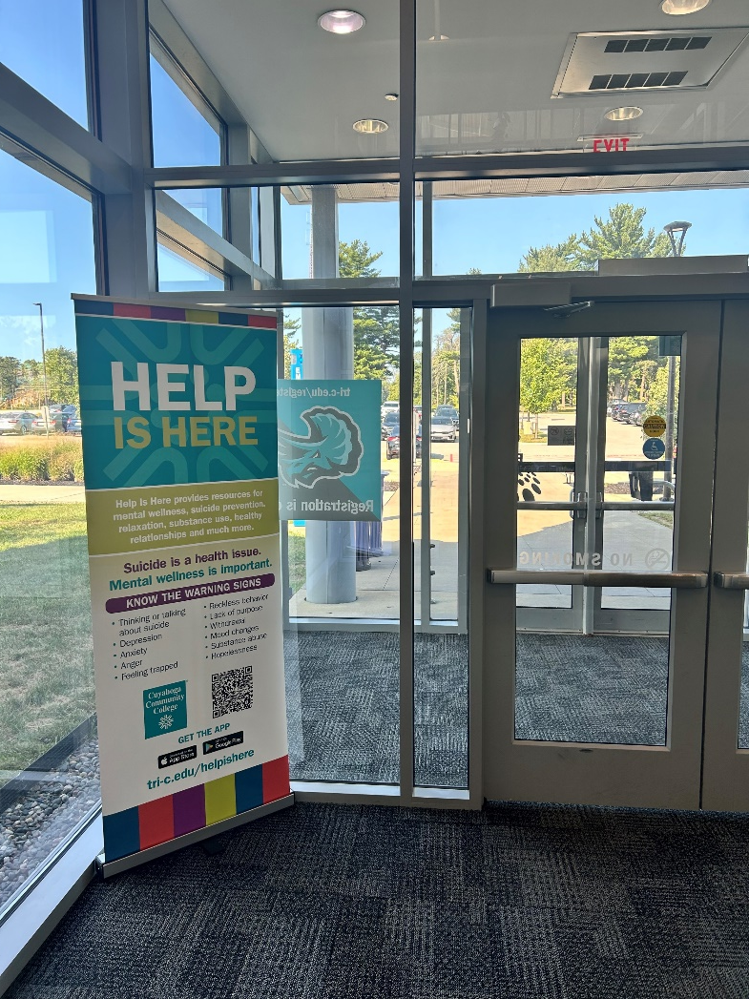
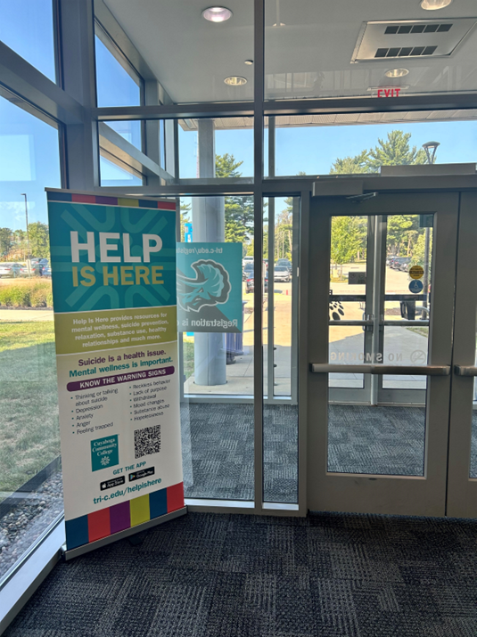
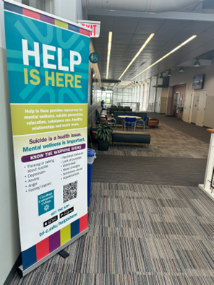
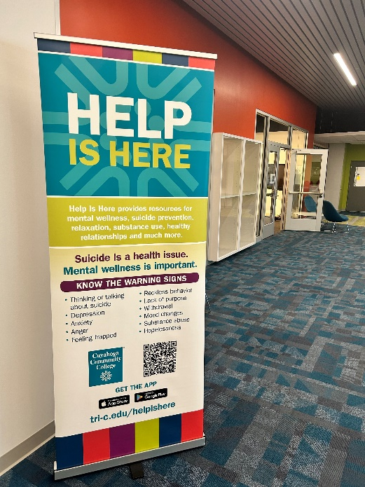
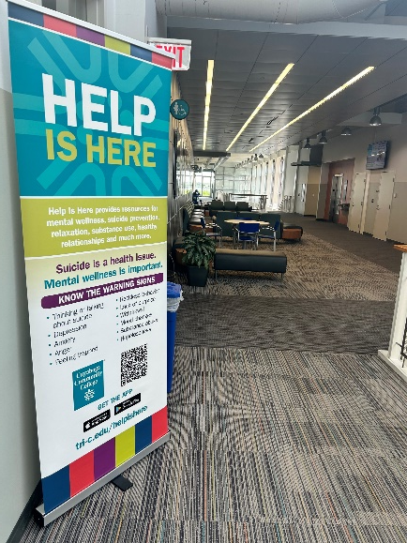
Ohio Department of Higher Education (ODHE) Mental Health Support Funding Grant
Objective 3:
Implement an aggressive information and education campaign
Improve awareness and access to resources

Slide 20
Help
Is
Here
Expand team
Add advisory council
Increase student involvement
Complete mobile app development
Education campaign
Social media campaign
Next steps?

Slide 21


Slide 22

Thank you!
Kevin Berg, PhD, MA, MSW, LSW
Associate Professor, Counselor
Kevin.Berg@tri-c.edu
Kevin Kuntz, EdS, LPCC-S, NCC
Professor, Counselor
Kevin.Kuntz@tri-c.edu
David Nardecchia, MEd, LPCC
Assistant Professor, Counselor
David.Nardecchia@tri-c.edu
Michelle Nicopolis, PhD, LPCC, Licensed Psychologist
Professor, Psychology
Michelle.Nicopolis@tri-c.edu

