Slide 1
Clinical High Risk for Psychosis: considerations for colleges and universities
Ohio Program for campus safety and mental health 3.4.25
Presenters:
Danelle Hupp, Ph.D. Harry sivec, ph.d Deb hrouda, ph.d.

Slide 2
objectives
Describe Clinical High Risk for Psychosis (CHR-P)
Discuss the role of colleges and universities in early identification and support
Identify sources of partnership and referral

Slide 3
Who we are: Best center
Best Practices in Schizophrenia Treatment (BeST) Center is a Coordinating Center of Excellence in the Department of Psychiatry at Northeast Ohio Medical University.
Mission is to promote recovery and improve the lives of an many people with schizophrenia-spectrum disorders and other serious mental health conditions – and their loved ones – as possible by accelerating the adoption of evidence-based and promising practices.
Provide expert training, consultation, and technical assistance to community mental health agencies and hospital systems, including for first episode psychosis, since 2009.

Slide 4
Best center & CHR-P
Substance Abuse and Mental Health Services Administration (SAMHSA) Clinical High Risk for Psychosis (CHR-P)
4-year grant to support starting specialty clinics for identification and treatment of CHR-P
BeST Center provided TA to a Wave 1 (2018) grantee
1 of 21 national sites
Grantee is a community mental health agency located in an urban setting
Agency has provided first episode psychosis programming for nearly 15 years

Slide 5
Clinical High Risk for Psychosis (CHR-P)
Mid to late 1990s: Concept of clinical high risk for psychosis originated with research from Australia and Europe, later expanded to United States
Emphasis on the “pre-psychosis” phase¹
Present with potentially prodromal or attenuated symptoms¹
Typically experience some kind of distress, so often seek help²
Could early intervention in the pre-psychosis phase help?

Slide 6
Broad OVERVIEW OF CHR-P initiative
Goal of prevention / delaying transition to psychosis
Prevention of psychosis onset
Better outcomes!
Clinical High Risk
Intervention
Delayed onset of psychosis

Slide 7
risk states
The first step is to identify who is at risk to develop psychosis
"Risk" for developing schizophrenia in general population hovers around 1%
Higher risk for developing psychosis when specific subclinical symptoms and risk factors are present⁹
Categories of higher risk: CHR-P syndromes
Attenuated Positive Symptom Psychosis Risk Syndrome (APS)
Brief Intermittent Psychotic Symptom Psychosis-Risk Syndrome (BIPS)
Genetic Risk and Deterioration Psychosis Risk Syndrome (GRD)

Slide 8
CHR-P: defining better Outcomes
Transition to psychosis without prevention or early intervention estimated as high as 35-54% within one year³³
With treatment:
Transition from "high risk" to psychosis: (2002-2012)^{9,31}
After one year: 22%
After two year: 29%
After three years: 36%
Transition from "high risk" to psychosis: Current⁶
After one year: 15%
After two year: 20%
After four years: 25-30%

Slide 9
CHR-p outcomes Summary points
Over time, the conversion rate has decreased to some extent⁶
Targeted interventions (CBTp) used in research trials have been associated with reduced risk of transition to psychosis within the first 1-2 years³²
Conclusions:
Early identification and intervention is warranted
For those who transition to psychosis, it is important to provide continued monitoring and service beyond initial 2-3 years¹³

Slide 10
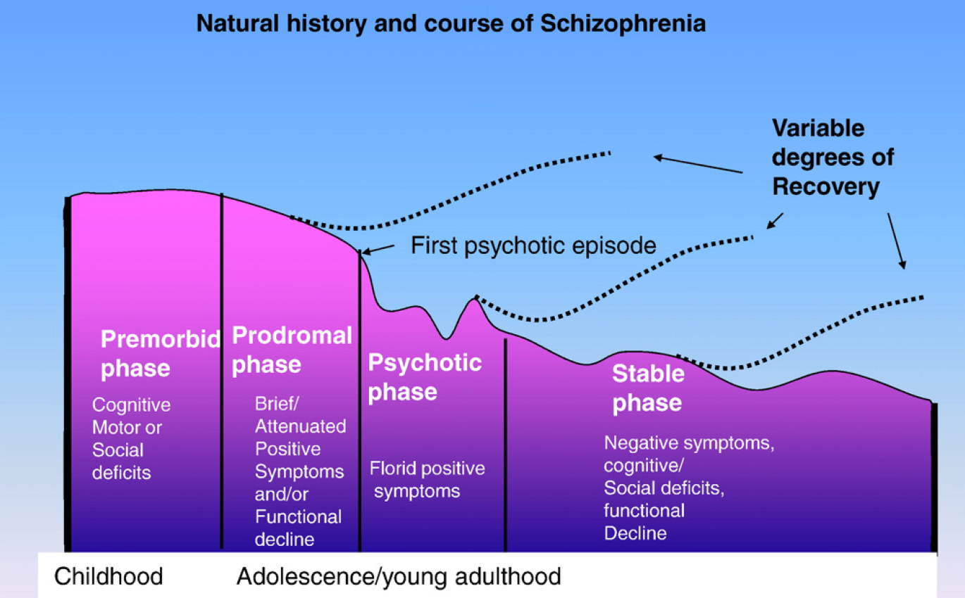
¹⁹
CHR-P

Slide 11
Identifying CHR-p groups

Slide 12
the college years: an opportunity
Psychosis onset tends to occur in late teens and early adult years
Majority of individuals with psychosis experienced positive symptoms of psychosis 2-3 years prior to developing full psychosis²⁰
Half of individuals in U.S. who are 18-24 years old attend college²⁰
College settings host the largest groups of individuals within the age range that is optimal time for identifying early predictors of future psychosis²⁰
Highlights the importance of screening and referring to appropriate services

Slide 13
College: Factors contributing to risk
At a common age where symptoms of early psychosis begin to appear
Stress-vulnerability model of psychosis
Vulnerability factors (familial risk; early trauma experiences)
Numerous common stressors that students face during the college years
New experiences: first serious romantic relationship, exploring identity/sexuality, new (or no) routine, limited (or no) supervision, moving away from home, etc.
New or increased substance use (alcohol, cannabis, stimulants)

Slide 14
The Cannabis-Psychosis association³⁷
Marijuana is a common drug of choice on college campuses
A great deal of research suggests that use of cannabis during teen years (<15-18) is associated with increased risk of developing a psychosis disorder³⁴
Psychosis risk increases with greater frequency of use, especially with high potency cannabis (risk of developing psychosis is dose-related)^{35,36}
Combined with other risk factors, use of substances is a significant variable to consider in psychosis risk

Slide 15
What are the signs to look for?

Slide 16
Early warning signs/indicators
Early warning signs are non-specific:^{9,14,19}
Feel as though something is “off” / “not quite right”
Trouble communicating clearly; difficulty putting words and sentences together clearly
Confusion; difficulty thinking clearly or concentrating; disorganized thoughts
Worsening in functioning; difficulties with work or school
Lessening interest in, and withdrawal from, interests/hobbies, activities, friends/family, people in general

Slide 17
Early warning signs/indicators
Early warning signs are non-specific:^{9,14,19}
Poor personal hygiene/self-care
Change in sleep habits
Fearful without cause
Emotional outbursts for no apparent reason
Odd thinking or behavior; hearing strange things
Baseline functioning begins to fail/deteriorate
Others start to notice/observe changes, likely beginning to have concerns

Slide 18
common comorbidities
Individuals at CHR-P often present to mental health services for other concerns
At baseline, more than 70% of CHR-P population had at least 1 diagnosable disorder⁴
Most common comorbid diagnoses⁷ (and reasons for seeking help²⁰): anxiety and depressive disorders^{7,20} and social phobia^{4 (as cited in 12)}
Many CHR-P individuals have 2-3 comorbid diagnoses⁷

Slide 19
Screening Tools
Screening tools for psychosis can be used to identify students in need of further assessment/follow-up
In a university counseling center setting, psychosis-risk screening is warranted – and crucial – for a fairly large portion of students seeking MH services²⁰
Roughly one-fourth of help seeking students screened positive in one study
Relatively large proportion may be experiencing distress and interference/ disruption because of psychotic-like experiences²⁰
Cast a wider net – consider routine, self-report screening measures

Slide 20
Simple screener
2-item, yes/no screen: piloted in a college counseling center⁸
"Do you see things that others can't or don't see?¹⁷
AND one of the following:
*"Have you ever felt that someone was playing with your mind?"¹⁷
"Do you ever hear the voice of someone talking that other people cannot hear?"¹⁷
"Do familiar surroundings sometimes seem unreal to you?"¹⁷
"Have you seen things that other people can't see or don't seem to see?"^{3,17}

Slide 21
Common screening tools
PRIME Screen – Revised: 12 items¹⁸
Prodromal Questionnaire – brief version (PQ-B): 21 item³
Both are brief, self-report instruments
Can be incorporated more routinely at intake or during screening/ assessment

Slide 22
Screening to Intervention pathway
Quick reference, generally speaking:
Absolute conviction about a belief or idea = psychosis
Distress about experiences, can consider alternative explanations of odd experiences, and maintain a level of awareness/insight that something is "off" = CHR-P

Slide 23
Screening to Intervention pathway
Positive screening would lead to referral for more thorough evaluation
Standardized measures are available to identify risk status
Structured Interview of Psychosis Syndromes scale (SIPS)³⁸
Early intervention only has a chance to work when:
Individuals at CHR-P are identified²⁰
Appropriate referrals are made
Early to screen, early to intervene!

Slide 24
Strategies for helping individuals who experience clinical high risk for psychosis

Slide 25
Treatment
Prevention is powerful!
Intervention prior to onset of full psychotic symptoms (i.e., CHR-P phase) may reduce or prevent duration of untreated psychosis²⁰
Targeted psychosocial interventions reduce frequency of conversion to psychosis (or delay the onset of symptoms, with better outcomes)⁹
International reviews emphasize access to:^{10,11,11a}
Tailored therapy (titrated to need)
Assessment
Case/care management
Close involvement of family and natural supports

Slide 26
system collaboration is key!
Effective identification and referral requires coordination among systems of care:
School systems
Colleges/universities
Faith-based organizations
988 or other crisis resources
Law enforcement
Primary care/pediatricians
Insurance (Medicaid, OhioRISE)

Slide 27
Colleges and universities within this system of care
Colleges and universities can proactively...

Slide 28
Increase awareness
Increase awareness of CHR-P and early psychosis
Awareness-raising and anti-stigma campaigns educating students, families, and campus staff about early psychosis and how to get help (for self, child, or friend)
Highlight the importance of a prompt referral to the college counseling center or local MH agency
Build up the local community's knowledge and response to young people at CHR-P/experiencing early psychosis

Slide 29
Provide training opportunities
Ensure college/university staff are trained in what to look for and what to do
Include student counseling center, student health center, resident advisors, faculty, campus/community faith leaders, etc.
Familiarize clinical staff with brief psychosis-spectrum screening tools – consider including as part of routine intake assessment²⁰

Slide 30
Provide training opportunities
Assist staff in developing psychosis literacy:
Knowledge of CHR-P/psychosis²¹
Ability to recognize signs/symptoms of early psychosis/psychosis²¹ to successfully identify students who might benefit from screening (and psychosis services)
Awareness of how students can access psychosis-specific services²¹
Confidence in providing help (support, resources, referrals) to students at CHR-P/experiencing early psychosis²¹

Slide 31
Develop internal screening PROCESS
Determine if/when/who to screen for CHR-P
Health center and counseling center?
Routine/universal screening as part of intake process?
Case-specific/when indicated?
Familial history?
Endorsement of certain symptoms?
Consider integration of brief screening items or tool for early psychosis into routine practice at health and counseling centers

Slide 32
Facilitate Connection to services
Connect students to student support services (e.g., accessibility services) for accommodations, if appropriate https://www.nri-inc.org/media/1552/nri_back_to_school_toolkit_staff_administrator.pdf
The more knowledgeable and prepared, the shorter the pathway to appropriate care for students at CHR-P/early psychosis
Likely that campus MH providers are not the student's first stop in their journey to find appropriate care and support
If a MH provider is not the student's initial contact, may indicate that they have less trust in MH clinicians/system and more negative thoughts about themselves (if they need MH care)²¹

Slide 33
Connect with community resources
Connect with internal and external resources:
National Alliance on Mental Illness (NAMI)
NAMI On Campus
College guide – for students: https://collegeguide.nami.org
Students with Psychosis
CURESZ Foundation (campus clubs)
Active Minds
The Jed Foundation
The Trevor Project
Bring Change to Mind
The Mental Health Coalition

Slide 34
Connect with community resources
Identify community partners
Accessible external partners in the local community who provide CHR-P/early psychosis services (e.g., accepting new patients; provide assessment, consultation, specialized psychosis services, *Coordinated Specialty Care for First Episode Psychosis)
Coordinate care to support students while they are in school and, if they take time off, when they return to school with the help of CSC programs
Make prompt referrals to external services, when appropriate

Slide 35
Summary: College and university Staff and administrators
Encouraged to:
Seek out or request additional training/consultation opportunities
Get comfortable with language used to discuss CHR-P (and early psychosis) – with students and parents

Slide 36
Summary: College and university clinical Staff
Encouraged to:
Inquire about psychosis-related experiences throughout treatment²⁰
Many individuals at CHR-P do not report these experiences unless specifically addressed²⁰
Avoid narrow focus on presenting problem²⁰ – likely seeking help for another issue
If a referral to a MH agency is needed, be prepared to provide the rationale for making the referral and discuss options – with students and (potentially) parents

Slide 37
Summary: College and university clinical Staff
Encouraged to:
Focus on strengthening protective factors (i.e., self-esteem, social support, resilience):²³
Those at CHR-P report significantly lower self-esteem, social support, and resilience²³
Lower social support and self-esteem associated with more severe positive and negative symptoms of psychosis²³

Slide 38
Considerations and potential challenges
CHR-P often presents as depression, anxiety, social problems,^{7,20} so including psychosis screening items that are brief might help to clarify factors leading to distress (and why the student is seeking help)
What can you do if a student (identified at CHR-P or experiencing early psychosis) does not want to be referred to external services?
Discuss and validate their hesitation (e.g., insurance, finances, does not want parent to know, fear, shame)
Discuss the limitation on number of sessions allowed and the purpose of services available through college counseling centers

Slide 39
Considerations and potential challenges
What can you do if a concerned student or faculty member reaches out to you about a student who may be at CHR-P or experiencing symptoms of early psychosis?
What can you do if a concerned parent contacts you?
Even when clinically indicated, many students may decline additional assessment or services.²⁰
What might increase the likelihood that a student agrees to engage in some level of care?

Slide 40
Considerations and potential Challenges
What can you do if no one in your local community specializes in CHR-P services?
This may very well be the case, as CHR-P programs aren't widely available yet
Refer to an agency/organization who works with individuals with psychosis. Look for Coordinated Specialty Care for First Episode Psychosis services near you: https://mha.ohio.gov/get-help/treatment-services/coordinated-specialty-care-for-first-episode-psychosis/providers-by-county/providers-by-county
Offer to call with them (or practice what to say)
Speak with the CSC for FEP team leader (generically or with permission)

Slide 41
Considerations and potential challenges
What can you do if no one in your local community specializes in CHR-P services?
ADVOCATE!
The more individuals identified, the more referrals.
The more referrals, the higher the demand.
Demand drives the MH system's response.
Reach out to your local MH Board, NAMI Ohio, local NAMI chapter, MH agencies – and encourage/request more readily available CHR-P and early psychosis services
Continue to provide supportive services and treatment until connected with external services

Slide 42
Resources for staff and administrators
Supporting students' success:
https://www.nri-inc.org/media/1552/nri_back_to_school_toolkit_staff_administrator.pdf
https://www.nri-inc.org/media/1576/nri_supporting_student_success_higher_education.pdf
National Alliance on Mental Illness (NAMI)
College guide – for educators: https://collegeguide.nami.org
Strong365: https://strong365.org/community/psychosis

Slide 43
Resources for clinical staff
SAMHSA's National Training and Technical Assistance Center for Early Serious Mental Illness
Screening, assessment, resources for individuals and families https://www.samhsa.gov/technical-assistance/esmi-tta/providers/identification-screening-assessment

Slide 44
Resources for clinicial staff: Screening tools
PRIME Screen – Revised: 12 items, self-report¹⁸ https://www.psychosisscreening.org/uploads/1/2/3/9/123971055/prime_screen--revised.pdf
Prodromal Questionnaire – brief version (PQ-B): 21 item, self-report³ For instrument: https://view.officeapps.live.com/op/view.aspx?src=https%3A%2F%2Floewylab.ucsf.edu%2Fsites%2Fg%2Ffiles%2Ftkssra7031%2Ff%2Fwysiwyg%2FPQ-B%2520English.docx&wdOrigin=BROWSELINK For scoring and instructions: https://easacommunity.org/wp-content/uploads/2023/09/PQ-B_InstructionsforOutreach.pdf
Washington Early Recognition Center Affectivity and Psychosis (WERCAP) screen: 16 item, self-report used to assess severity of mood and psychotic symptoms and estimated risk for developing bipolar disorder or a psychotic disorder^{29,30} https://werc.wustl.edu/Content/pdfs/WERCAP%20Screen%202022.pdf

Slide 45
Resources for clinical staff: assessment tools
Mini-Structured Interview for Psychosis-Risk Syndromes (Mini-SIPS): interview, 20-30 minutes¹⁶ For training and instrument: https://campuspress.yale.edu/napls/other-resources/
Comprehensive Assessment of At-Risk Mental States 23 (CAARMS 23): semi-structured interview ²⁷ For training, manual, record, and instrument: https://www.orygen.org.au/Training/Resources/Psychosis/Manuals/CAARMS

Slide 46
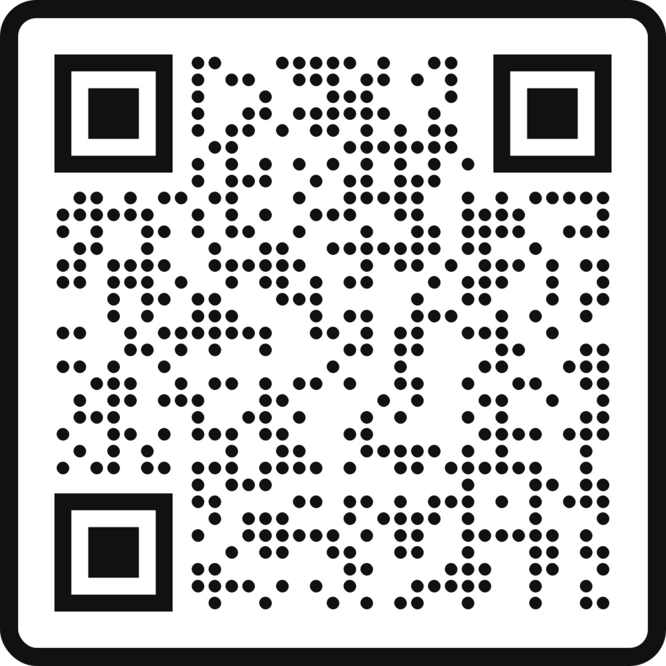
Resources for colleges and universities
BeST Center at NEOMED
bestcenter@neomed.edu
(330) 325-6776

Slide 47
Resources for colleges and universities
Ohio Systems of Care (SOC) ECHO for Youth Involved with Multiple Systems
Ideal forum for addressing the complex needs of children, youth, and families served by Ohio Systems of Care for youth involved with multiple systems
A public service offered by Best Practices in Schizophrenia Treatment (BeST) Center at NEOMED, Center for Innovative Practices at Case Western Reserve University, Ohio Colleges of Medicine Government Resource Center, Ohio Department of Developmental Disabilities, Ohio Department of Medicaid and Ohio Department of Mental Health & Addiction Services
Learn more at: https://socohio.org/soc-echo
Register at: https://iecho.org/public/program/PRGM1713974538045ODNZAWZZNR

Slide 48
Think about your current role...
What questions do you have?
What would you like to learn more about?
Where do you see additional opportunities in your community for prevention/early intervention?
How might the information shared today be applied in your college and local community?

Slide 49
To learn more:
If you are interested in learning more or potentially bringing a BeST Center program to your area/organization, contact us at:
bestcenter@neomed.edu
(330) 325-6776

Slide 50
REFERENCES
¹Fusar-Poli et al. (2013). The psychosis high-risk state: A comprehensive state-of-the-art review. JAMA Psychiatry, 70(1), 107-120. doi: 10.1001/jamapsychiatry
²Parsons (Path), E. (September 9, 2022). Update on psychosis risk syndrome research: Recent findings and major initiatives. Presented at the 2022 Community Education Day for Psychosis (Stanford INSPIRE Clinic – UCSF Path Program). Virtual. https://med.stanford.edu/psychiatry/patient_care/inspire/2022communityday.html
³Loewy, R., Pearson, R., Vinogradov, S., Bearden, C., & Cannon, T. (2011). Psychosis risk screening with the prodromal questionnaire – brief version (PB-Q). Schizophrenia Research, 129(1), 42-46. doi: 10.1016/j.schres.2011.03.029
⁴Menefee (Cohen), E. (March 18, 2021). Early psychosis syndromes: Building programs for the future. Presented at the Research Seminar in Child and Adolescent Psychiatry. Denmark.
⁵Addington, J., Liu, L., Buchy, L., Cadenhead, K., Cannon, T., Cornblatt, B., Perkins, D., Seidman, L., Tsuang, M., Walker, E., & Woods, S. (2015). North American prodrome longitudinal study (NAPLS 2): The prodromal symptoms. The Journal of Nervous and Mental Disease, 203(5), 328-335. Doi: 10.1097/NMD.0000000000000290

Slide 51
REFERENCES
⁶Lundin, N. B., Blouin, A., Cowan, H., Moe, A., Wastler, H., & Breitborde, N. (2024). Identification of psychosis risk and diagnosis of first-episode psychosis: Advice for clinicians. Psychology Research and Behavior Management, 17, 1365-1383. doi: 10.2147/PRBM.S423865
⁷Addington, J., Piskulic, D., Liu, L., Lockwood, J., Cadenhead, K., Cannon, T., Cornblatt, B., McGlashan, T., Perkins, D., Seidman, L., Tsuang, M., Walker, E., Bearden, C., Mathalon, D., & Woods, S. (2017). Comorbid diagnoses for youth at clinical high risk of psychosis. Schizophrenia Research, 190, 90-95. doi: 10.1016/j.schres.2017.03.043
⁸Phalen, P., Rakshan Rouhakhtar, P., Millman, Z., Thompson, E., DeVylder, J., Mittal, V., Carter, E., Reeves, G., & Schiffman, J. (2018). Validity of a two-item screen for early psychosis. Psychiatry Research, 270, 861-868. doi: 10.1016/j.psychres.2018.11.002
⁹Van der Gaag, M., Nieman, D., & van den Berg, D. (2013). CBT for Those at Risk of a First Episode Psychosis. Evidence-based psychotherapy for people with an “At Risk Mental State’. London: Routledge. doi: 10.4324/9780203503478
¹⁰Estradé, A., Spencer T.J., De Micheli, A, Murguia-Asensio, S., Provenzani, U., McGuire, P., & Fusar-Poli, P. (2023). Mapping the implementation and challenges of clinical services for psychosis prevention in England. Front. Psychiatry, 13:945505. doi: 10.3389/fpsyt.2022.945505

Slide 52
REFERENCES
¹¹Salazar de Pablo, G., Estradé, A., Cutroni, M., Andlauer, O., & Fusar-Poli, P. (2021). Establishing a clinical service to prevent psychosis: What, how and when? Systematic review. Translational Psychiatry 11(1), 43. doi: 10.1038/s41398-020-01165-x
^{11a}Salazar de Pablo, G., Radua, J., Pereira, J., Bonoldi, I., Arienti, V., Besana, F., Soardo, L., Cabras, A., Fortea, L., Catalan, A., Vaquerizo-Serrano, J., Coronelli, F., Kaur, S., Da Silva, J., Shin, J., Solmi, M., Brondino, N., Politi, P., McGuire, P., & Fusar-Poli, P. (2021). Probability of transition to psychosis in individuals at clinical high risk: An updated meta-analysis. JAMA Psychiatry, 78, 970-978. doi: 10.1001/jamapsychiatry.2021.0830
¹²Chan, V. (2017). Schizophrenia and psychosis: Diagnosis, current research trends, and model treatment approaches with implications for transitional age youth. Child and Adolescent Psychiatric Clinics of North America, 26(2), 341-366. doi: 10.1016/j.chc.2016.12.014
¹³Beck, K., Studerusa, Andreoua, Egloffb, Leanzaa, Simond, Borgwardtf, Riecher-Rösslerg (2019). Clinical and functional ultra-long-term outcome of patients with a clinical high risk (CHR) for psychosis. European Psychiatry 62, 30–37.

Slide 53
REFERENCES
¹⁴Schiffman, J. (August 21, 2020). Clinical high risk for psychosis: Screening, assessment, and treatment. Presented at the 2020 Southwest First Episode Psychosis Conference. Virtual. https://mhttcnetwork.org/products_and_resources/clinical-high-risk-for-psychosis-screening-assessment-and-treatment/
¹⁵Achenbach, T., & Rescorla, L. (2001). Manual for the ASEBA school-age forms & profiles: An integrated system of multi-informant assessment.
¹⁶Woods, S., Walsh, B., & Cannon, T. (2020). Mini-SIPS 1.0: https://bpb-us-w2.wpmucdn.com/campuspress.yale.edu/dist/3/240/files/2020/06/Mini-SIPS-version-1-0-041920.pdf
¹⁷Ord, L., Myles-Worsley, M., Blades, F., & Ngiralmau, H. (2004). Screening for prodromal adolescents in an isolated high-risk population. Schizophrenia Research, 71(2-3), 507-508. doi: 10.1016/jschres.2004.03.014
¹⁸Miller, T., Cicchetti, D., Markovich, P., McGlashan, T., & Woods, S. (2004). The SIPS screen: A brief self-report screen to detect the schizophrenia prodrome. Schizophrenia Research, 70(1), 78.
¹⁹Tandon, R., Nasrallah, H. A., & Keshavan, M. S. (2009). Schizophrenia, "just the facts" 4. Clinical features and conceptualization. Schizophrenia Research, 110(1-3), 1–23. doi: 10.1016/j.schres.2009.03.005

Slide 54
REFERENCES
²⁰Thompson, E., Andorko, N., Rakhshan Rouhakhtar, P., Millman, Z., Sagun, K., Han, S., Chibani, D., Reeves, G., Herman, B., & Schiffman, J. (2022). Psychosis-spectrum screening and assessment within a college counseling center: A pilot study exploring feasibility and clinical need. Journal of College Student Psychotherapy, 36(2), 201-222. doi: 10.1080/87568225.2020.1797604
²¹Crisanti, A., Saavedra, J., Barans, S., Romero, P., Dark, N., Friedman, B., Lardier, D., Bustillo, J., Tohen, M., Lenroot, R., & Murray-Krezan, C. (2025). Identifying barriers and pathways to care among college students at risk of or diagnosed with first episode psychosis. Psychiatry International, 6(1), 15. doi: 10.3390.psychiatryint6010015
²²Cotter, D., Healy, C., Staines, L., Mongan, D., & Cannon, M. (2022). Broadening the parameters of clinical high risk for psychosis. American Journal of Psychiatry, 179(9), 593-595. doi: 10.1176/appi.ajp.20220612
²³Shi, J., Wang, L., Yao, Y., Chen, F., Su, N., Zhao, X., & Zhan, C. (2016). Protective factors in Chinese university students at clinical high risk for psychosis. Psychiatry Research, 239, 239-244. doi: 10.1016/j.psychres.2016.03.036
²⁴Cowan, H., & Mittal, V. (2021). Three types of psychotic-like experiences in youth at clinical high risk for psychosis. European Archives of Psychiatry and Clinical Neuroscience, 271(4), 733-744. doi: 10.1007/s00406-020-01143-w

Slide 55
REFERENCES
²⁵Joa, I., Bjornestad, J., Johannessen, J., Langeveld, J., Stain, H., Weibell, M., & Hegelsted, W. (2021). Early detection of ultra high risk for psychosis in a Norwegian catchment area: The two year follow-up of the prevention of psychosis study. Frontiers in Psychiatry, 12, 573905. doi: 10.3389/fpsyt.2021.573905
²⁶Wu, J., Long, X., Liu, F., Qi, A., Chen, Q., Guan, X., Zhang, Q., Yao, Y., Shi, J., Xie, S., Yan, W., Hu, M., Yuan, X., Tang, J., Wu, S., Zhang, T., Wang, J., & Lu, Z. (2021). Screening of the college students at clinical high risk for psychosis in China: A multicenter epidemiological study. BMC Psychiatry, 21(1), 253. doi: 10.1186/s12888-021-03229-8
²⁷Haining, K., Gajwani, R., Gross, J., Gumley, A., Lawrie, S., Schultze-Lutter, F., Schwannauer, M., & Uhlhaas, P. (2024). Clinical and functional outcomes of community-recruited individuals at clinical high-risk for psychosis: Results from the youth mental health risk and resilience study (YouR-Study). Schizophrenia Bulletin Open, 5(1), sgae019 .doi: 10.1093/schizbullopen/sgae029
²⁸Thompson, E., Frost Visser, K., Schiffman, J., Spirito, A., Hunt, J., & Wolff, J. (2022). Preliminary evidence supporting the practice of psychosis-risk screening within an inpatient psychiatric setting serving adolescents. Psychiatry Research, 307, 114322. doi: 10.1016/j.psychres.2021.114322

Slide 56
REFERENCES
²⁹Mamah, D. The Washington Early Recognition Center Affectivity and Psychosis (WERCAP) Screen. Washington University, St. Louis, Missouri. 2011. https://werc.wustl.edu/Content/pdfs/WERCAP%20Screen%202022.pdf
³⁰Mamah, D., Mutiso, V., & Ndetei, D. (2022). Longitudinal and cross-sectional validation of the WERCAP screen for assessing psychosis risk and conversion. Schizophrenia Research, 241, 201-209. doi:10.1016/j.schres.2022.01.031
³¹Fusar-Poli, P., Bonoldi, I., Yung, A., Bogwardt, S., Kempton, M., Valmaggia, L., Barale, F., Caverzasi, E., & McGuire, P. (2012). Predicting psychosis: A meta-analysis of transition outcomes in individuals at high clinical risk. Archives of General Psychiatry, 69, 220-229. doi: 10.1001/archgenpsychiatry.2011.1472
³²Hutton, P., and Taylor, P.J. (2014). Cognitive behavioural therapy for psychosis prevention: A systematic review and meta-analysis. Psychological Medicine, 44, 449-468. doi:10.1017/S0033291713000354
³³Bechdolf, A., Phillips, L., Francey, S., Leicester, S., Morrison, A., Veith, V., Klosterkotter, J., & McGorry, P. (2006). Recent approaches to psychological interventions for people at risk of psychosis. European Archives of Psychiatry and Clinical Neuroscience, 256(3), 159-173. doi: 1007/s00406-006-0623-0

Slide 57
REFERENCES
³⁴Gage, S., Hickman, M., & Zammit, S. (2016). Association between cannabis and psychosis: Epidemiologic evidence. Biological Psychiatry, 79(7), 549-556. doi: 10.1016/j.biopsych.2015.08.001
³⁵Marconi, A., Di Forti, M., Lewis, C., Murray, R., & Vassos, E. (2016). Meta-analysis of the association between the level of cannabis use and risk of psychosis. Schizophrenia Bulletin, 42(5),1262-1269. doi: 10.1093/schbul/sbw003
³⁶Di Forti, M., Sallis, H., Allegri, F., Trotta, A., Ferraro, L., Stilo, S., Marconi, A., La Cascia, C., Marques, T., Pariante, C., Dazzan, P., Mondelli, V., Paprelli, A., Kolliakou, A., Prata, D., Gaughran, F., David, A., Morgan, C., Stahl, D. …& Murray, R. (2014). Daily use, especially of high-potency cannabis, drives the earlier onset of psychosis in cannabis users. Schizophrenia Bulletin, 40(6),1509-1517. doi: 10.1093/schbul/sbt181
³⁷Pierre, J. (2017). Risks of increasingly potent Cannabis: The joint effects of potency and frequency. Current Psychiatry, 16, 14-20.
³⁸McGlashan, T., Walsh, B., & Woods, S. (2001). Structured Interview for Psychosis-Risk Syndromes (Version 5.5, March 2014). PRIME Research Clinic, Yale School of Medicine, New Haven: CT. https://easacommunity.org/wp-content/uploads/2023/09/SIPS_5-5_0325141-correct.pdf

