Slide 1
Using Adaptive & Crisis Leadership Principles to Transition College Mental Health during the Pandemic
Katharine Oh & Brittany Sommers
Cleveland State University
December, 2020
Notes:
KO

Slide 2
Outline
How We Became an Adaptive Team before 2020
Managing resistance, Focusing on purpose/values, Experimenting
March 2020 – Crisis Leadership
What we did, How we did it, How it felt!
Prioritize, Delegate, Trust, Over-communicate, Provide Needs
Discussion
What values guided your team’s changes?
What principles from crisis leadership can you use?
How can you increase your team’s adaptability?
Notes:
What would you like to gain from spending this hour together? BKS

Slide 3
How We Became an Adaptive Team (Heifetz, Grashow, Linsky)
2014: Director retired; Interim Director led change to hire PT counselors to see lots of clients; set first session limit (16)
2015: External Director hired; VPSA increased the heat: need to develop new service delivery model to get rid of Waitlist – 1 month deadline
Managed Resistance –
Named the losses at risk
Identified competing commitments
Focused on essential purpose/ values
Led collaborative process
Maintained the heat at a productive level (clear deadline – if we didn’t design the model, the VPSA would)
Notes:
KO

Slide 4
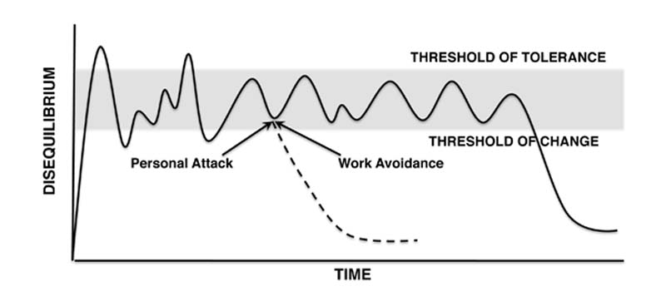
Productive Zone of Disequilibrium (Heifetz, Grashow, Linsky)
Notes:
KO

Slide 5
How We Stay an Adaptive Team (Heifetz, Grashow, Linsky)
Take an Experimental Approach
Developed regular habit of tweaking the operation together
Tell the stories, Tell the numbers
Assessment practicum example
Engage as Whole People
Rumbling with vulnerability
Living our values individually and collectively
Well aware of our individual strengths
Connect to Purpose
Value discussions and mission statement review
Emphasis on access to care for students and quality training
Shifted to Public Health approach – every student’s mental health is our responsibility
Notes:
BKS

Slide 6
March 2020 World Health Organization Declares COVID-19 a Pandemic
Cleveland State acts quickly to shift all non-essential employees off campus and remove to all-remote classes = Crisis Leadership needed.
Notes:
BKS

Slide 7
Crisis Leadership - Prioritize - Delegate - Trust - Over-communicate - Meet Needs
Notes:
KO

Slide 8
Leadership Principles I Drew On:
Strengths-Based Leadership: Great Leaders, Teams, and Why People Follow, Barry Conchie and Tom Rath
4 Needs of Followers
Trust
Compassion
Stability
Hope
Extreme Ownership: How US Navy Seals Lead and Win, Jocko Willink & Leif Babin
Prioritize
Delegate
Trust the people you’ve delegated to
Over-communicate
Notes:
KO

Slide 9
What Did I Do? – Director’s perspective
Held a Meeting via Zoom to prepare the team – Thursday, March 12
Began making major decisions & delegating tasks – tech infrastructure first, then services, then training decisions
Came in on Sunday to create structure for transition – consulted with team for big decisions – Sunday, March 15
Keep all trainees working – “Supervisor on Call” at all times
Continue Group Counseling
Discontinue Assessment
Created standard instructions for all staff and trainees
For first telehealth session
to get telehealth consent
to manage suicide risk/ hospitalization
Daily Staff Check-Ins the first 2 weeks to support the transition – Over-communicating! March 16 – last day in office
Notes:
KO –
1st Meeting: beginning of over-communicating as a way to support the team and allow us to transition together emotionally and practically
Major Decisions – Trust: my team know that I can make clear decisions in a pinch, and I took the reins quite a bit to get everything moving into the change, Prioritized: starting with tech needs to make it possible, then decisions about services, then training
Came in on Sunday – consulted with team on key decisions (will we continue to lead groups? Will the Interns continue to supervise Practicum counselors? Will we have all of our trainees provide telehealth?) – decisions based on student population and our key values (access), based on current trainees’ abilities (confident in their ability to provide good telehealth)
Standard instructions: wanted to provide a clear touchstone for the shift – Basic Telehealth training for all, reviewed the training together in staff meeting, instructions for first telehealth session, telehealth consent, risk assessment/ hospitalization instructions, etc.
Daily Staff Check-Ins: continued to meet to troubleshoot tech issues, learn from each others’ telehealth experiences, check in on well-being and how folks were managing the change – Compassion but also very practical support and operations management
Week 1: all clients were either met by phone, online, or were call to reschedule to the following week; staff focused on learning Telehealth and getting familiar with online platform
Week 2: all client sessions were held by phone or online; Group Counseling resumed
Week 3: encouraged all counselors to embrace the online platform and begin using this for almost all sessions
To instill Hope – communicated the whole time my faith in the team to adapt, given our history of being able to adapt to changes

Slide 10
How Did I Feel?
Difficult to focus as new considerations would pop into my mind or I would remember a task I needed to do
Overwhelmed, tense
Lonely at times – moving sooner and faster than other CC’s, alone with the complexity of the entire project
Exhilarated that we were accomplishing the transition
Confident in my team, closer to my team than usual
Notes:
KO – How did you feel during your own transition? Maybe post words or phrases in the Chat.

Slide 11
What Did I Do? – Staff Psychologist
Stability
Held all meetings with clients as scheduled
Sup of sup facilitator
Telehealth informed consent, Technology directions, Shared files
Trust
Clarified responsibilities, then made decisions independently
“Do not make a policy when a decision will do” (Dr. Frances Lucas)
Getting groups running practically, resource sharing
Compassion
Not expecting others to perform at full capacity (Brené Brown)
What am prepared to offer to someone who needs respite? (Mia Birdsong)
Notes:
BKS

Slide 12
How Did I Feel?
Distracted by emotions and practicalities of pandemic- worried/scared/angry
So confident in our team
Unified/connected in our shared values and focus
Lonely- switch to virtual
Excited about increased access potential
Notes:
BKS

Slide 13
Discussion
What Values/ Purpose guided your team during your pandemic transition?
How might you use principles from Crisis Leadership in your work? (Prioritize, Delegate, Trust, Over-communicate)
How might you use Adaptive Leadership strategies to increase your team’s ability to adapt? (Manage resistance, Take an Experimental Approach, Engage as whole people, Focus on purpose)
Notes:
Both

Slide 14
References
Birdsong, M. (2020). How we show up: Reclaiming family, friendship, and community. New York City, NY: Hachette Go.
Brown, B. (2018). Dare to Lead Brave Work. Tough Conversations. Whole Hearts. New York CIty, NY: Random House.
Heifetz, R. A., Grashow, A., & Linsky, M. (2009). The practice of adaptive leadership: Tools and tactics for changing your organization and the world. Boston, MA: Harvard Business Press.
Rath, T., & Conchie, B. (2008). Strengths based leadership: Great leaders, teams, and why people follow. New York City, NY: Gallup Press.
Willink, J., & Babin, L. (2017). Extreme ownership: How U.S. Navy SEALs lead and win. New York City, NY: St. Martin's Press.

