Slide 1
Ohio’s New Suicide Prevention Plan and Higher Education Opportunities for Higher-Education & How you can play a role

Slide 2
Agenda
Overview of the Ohio Suicide Prevention Foundation (OSPF)
The Suicide Prevention Plan for Ohio
Background
Elements
How college campuses can play a role in implementation
Interprofessional Suicide Prevention Course
REACH OUT Suicide Prevention App
Training Opportunities
Open Discussion / Q&A

Slide 3
History of The Suicide Prevention Plan for Ohio: What makes Ohio’s Plan so unique?

Slide 4
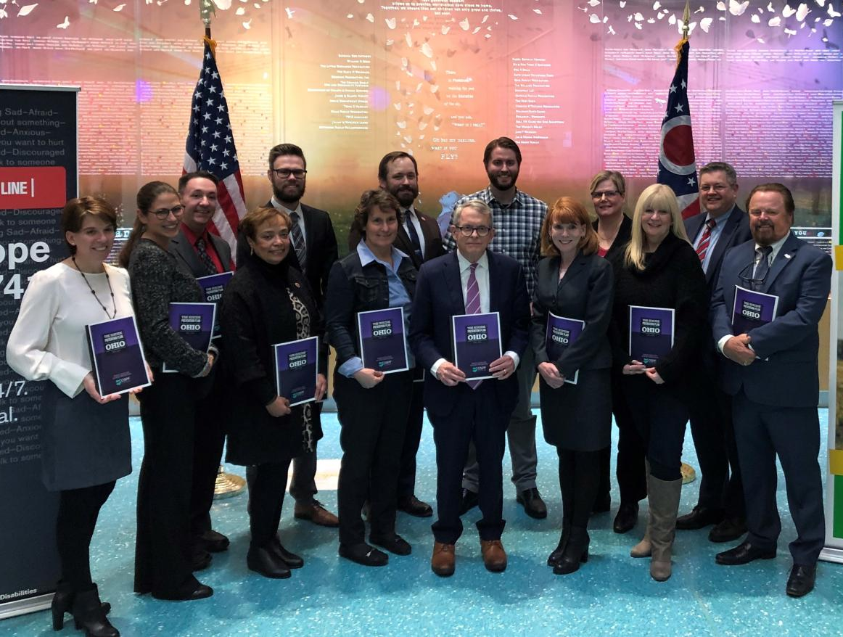
Suicide Prevention Plan for Ohio Released February 28, 2020

Slide 5
The Planning Team
Governor’s Office
Ohio Department of Mental Health & Addiction Services
Ohio Suicide Prevention Foundation
Ohio Department of Health
Ohio Department of Aging
University of Cincinnati
Ohio Department of Education
CareSource
Ohio Department of Veterans Services
Ohio National Guard
Veteran’s Administration
Ohio Mental Health and Addiction Advocacy Coalition
PrimaryOne Health
Nationwide Children’s Hospital
Peg’s Foundation
Coalitions
Dr. Mike Hogan

Slide 6
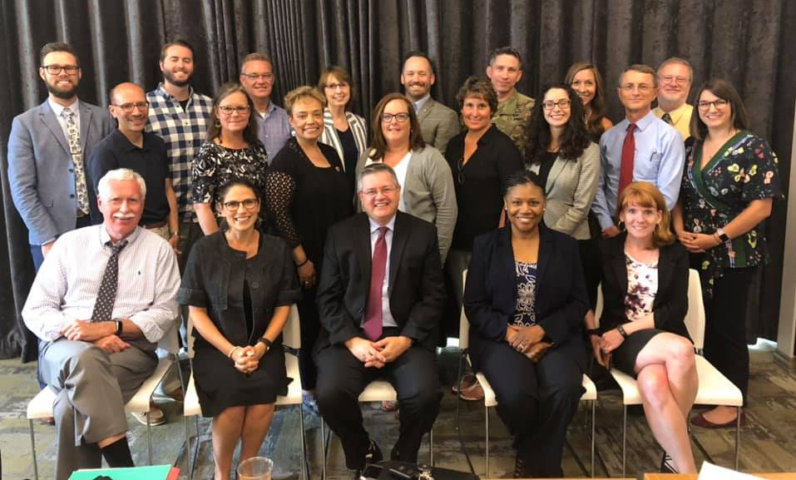
The implementation team
The Implementation Team will ensure the plan is being used across the state and all goals and objectives are being addressed.
The team will create measures to track the progress of the plan. Based on these measures, a report card will be created showing the progress of suicide prevention across all sectors in Ohio.
The Suicide Prevention Plan for Ohio is a living document. Adjustments will be made as needed. Any changes will be data-driven.
Updates and reports will be sent to annually legislators and the Governor

Slide 7
Vision Statement
Ohio will reduce the number of suicides every year until not one life is lost.

Slide 8
state OF OHIO SUICIDE PREVENTION PLAN: Intended Outcomes
Reduction in suicidality:
Fewer number of suicides—decrease by 10% over three years.
Fewer number of attempted suicides.
Improved identification of those thinking of suicide.

Slide 9
state OF OHIO SUICIDE PREVENTION PLAN: Core assumptions
Suicide is a preventable public health issue. Ohio will:
Work together to prevent suicide.
Implement universal, selected, and indicated prevention as part of a comprehensive approach.
Focus on those with elevated suicide risk factors.
Identify and address barriers to competent suicide care.
Ensure suicide care is accessible and effective.
Promote postvention as a vital part of suicide prevention.

Slide 10
state OF OHIO SUICIDE PREVENTION PLAN: Core assumptions
Interventions and approaches will be data and research driven and culturally appropriate.
Ohio will increase public awareness about suicide and provide tools for responding effectively.
Strengthen the knowledge and skills of Ohio’s workforce in identifying individuals at risk for suicide and intervening.
Substantial resources are necessary for a sustained effort to effectively decrease the suicide rate
Stigma reduction through culture change will make appositive impact on suicide prevention.
Suicide prevention and postvention efforts must be evaluated for efficacy, impact, and continuous improvement through accurate data collection and analysis.
All efforts will be considered thought a health-equity lens.

Slide 11
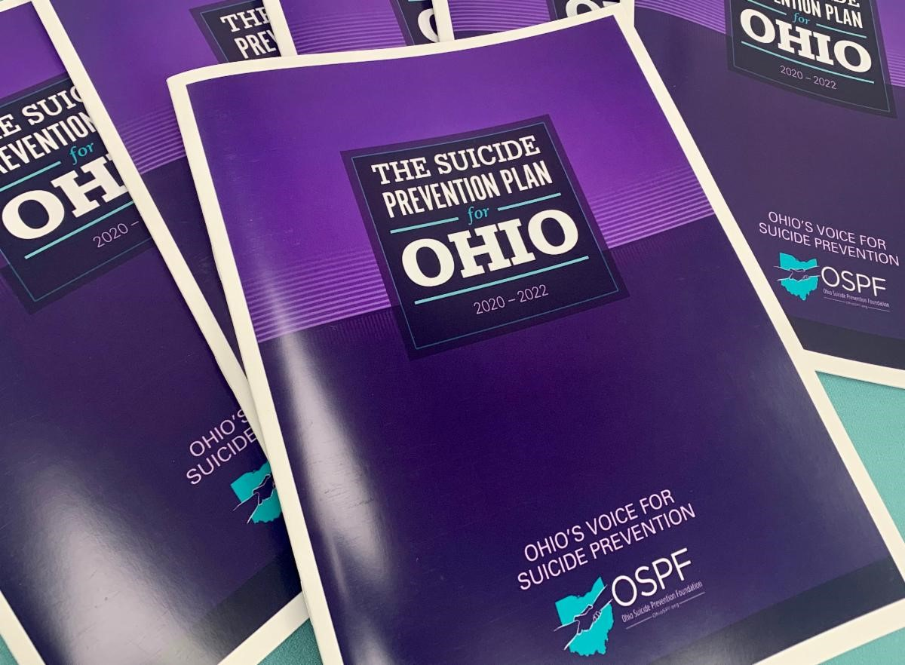
Ohio: Strategy One
All Ohioans will recognize the warning signs and risk factors of suicide and respond appropriately.

Slide 12
Ohio: Strategy TWO
Ohio will concentrate efforts on integrating suicide prevention practices and suicide care, including postvention, into high-impact systems including health care, public safety, and education.

Slide 13
Ohio: Strategy THREE
Ohio will build suicide prevention capacity and infrastructure at the organizational, local, and state levels.

Slide 14
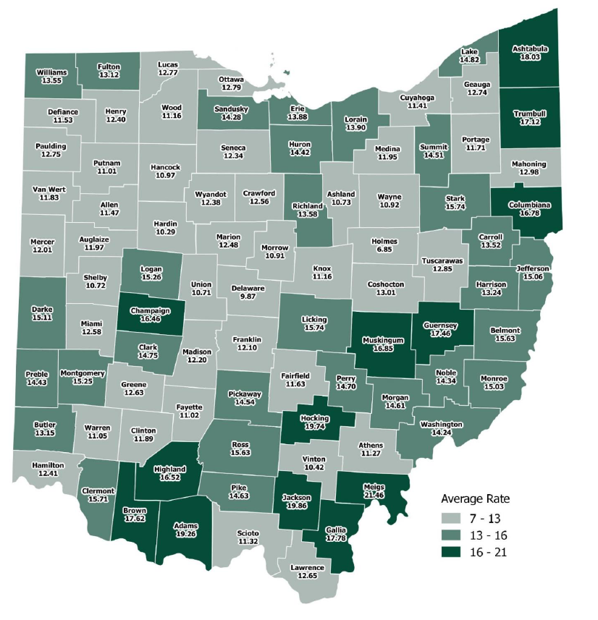
Ohio: Strategy Four
Ohio will concentrate prevention efforts on groups that current data has identified as being high risk for
suicide, including:
• Youth, ages 10-24
• Males, ages 25-59
• Veterans and military members
• Residents of highest-risk Appalachian counties
• Community population focus as identified by local data

Slide 15
Ohio: Strategy FIVE
Ohio will standardize, gather, and utilize data to continuously inform and evaluate its approach.

Slide 16
Ohio: Strategy TWO
Ohio will concentrate efforts on integrating suicide prevention practices and suicide care, including postvention, into high-impact systems including health care, public safety, and education.

Slide 17
Strategy 2 Major Progress Updates: Austin Lucas
Goal 2, Objective 1: “Promote the adoption of core education and training guidelines regarding suicide prevention into the higher education curricula of health professions”.
Performance Measure: Ohio Institutions of Higher Education will adopt suicide prevention care into curriculums by December 31, 2022.
Action: OSPF finalizing a marketing plan for the Interprofessional Suicide Prevention Curriculum.
Next Step: Disseminate survey on higher-education suicide prevention activities across Ohio.

Slide 18
Strategy 2 Major Progress Updates: Austin Lucas
Goal 2, Objective 2: “Promote core education and training guidelines in suicide prevention best practices for professional licensing boards and related entities”.
Performance Measure: Advocate with Ohio Professional Licensing Boards and entities to adopt updated suicide-specific best practice standards by July 1, 2023.
Action: Implementation members advocating the marketing of suicide prevention hours with various professional licensing boards.

Slide 19
Interprofessional Suicide Prevention Course
Most counselors, social workers, therapists, etc. DO NOT receive education on suicide prevention while in college (undergraduate or graduate).
Through a SAMHSA GLS Grant, OSPF funded the development and implementation of an IPE suicide prevention course at:
The University of Cincinnati
Old Dominion University
University of North Carolina (Charlotte)
Three formats:
In-person
Blended
Online

Slide 20
Interprofessional Suicide Prevention Course
What types of institutions can adopt the course
Public, 4-year universities
Private not-for-profit universities
Private, for-profit universities
Community Colleges
What types of students can take the course
Health professions students (both undergraduate and graduate students):
Counseling
Social Work
Public Health
Psychology
Medicine
Ethics
Law
Nursing
Other relevant disciplines

Slide 21
Interprofessional Suicide Prevention Course
Overview of Major Topics
Foundational Competencies in Suicide Prevention
Community-Based Competencies (Primary Prevention & Postvention)
Social/Interpersonal & At-Risk Group Competencies (Secondary Prevention)
Clinical/Individual Competencies (Tertiary Prevention)

Slide 22
Interprofessional Suicide Prevention Course
Key Findings
The interprofessional suicide prevention course demonstrated sizable gains in suicide prevention related efficacy and knowledge.
Increases in perceived ability to help self-harming patients, suicide prevention knowledge, and beliefs that persons dying by suicide possess characteristics consistent with depression and isolation.
Participants expressed notably high intent to engage in best available intervention and prevention practices, draw on best available public health practices, and participate in interprofessional teams.

Slide 23
Interprofessional Suicide Prevention Course
Adopting institutions will get:
All course materials
Syllabus
Course user manual
All sample lecture PPTs
All quizzes & exams
All sample projects
A chance to consult with the instructors/researchers

Slide 24
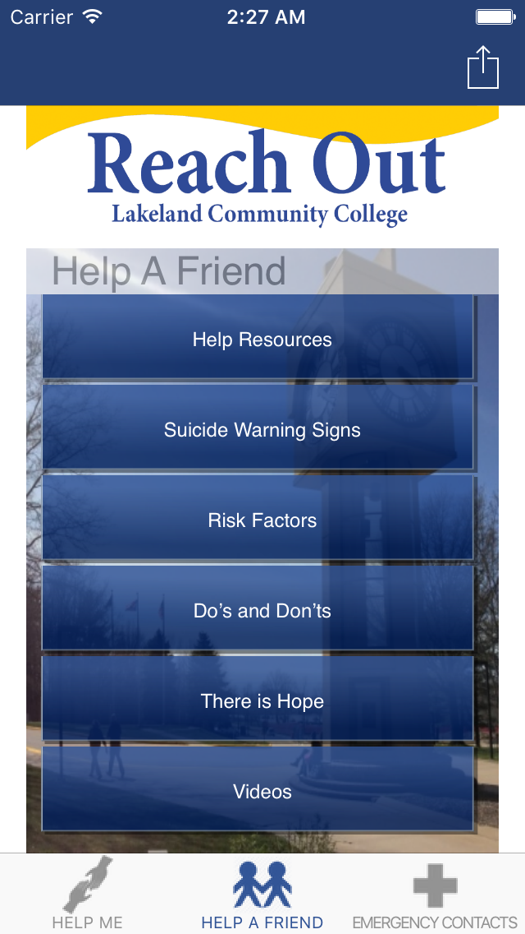
REACH OUT App for college campuses
OSPF & Lakeland Community College
Funding through SAMSHA GLS Grant to customize app for 15 Ohio colleges
Comprehensive suicide prevention app for college students
How to help yourself
How to help a friend
Campus & Local resources
Suicide Warning Signs

Slide 25
REACH OUT App for college campuses
How can your campus customize the app?
Relatively inexpensive to customize
GEERs Funding
Contract with Lakeland Community College
Application Process
Involvement of IT department
Marketing department
Counseling department

Slide 26
OSPF Offering Free QPR Trainings
Question, Persuade, Refer (QPR)
Evidenced-Based suicide prevention gatekeeper training.
How to have a conversation with someone that is suicidal.
OSPF offering QPR for students and faculty/staff
Free
Virtual and in-person options available
General sessions or scheduled sessions for specific institutions

Slide 27
Open discussion: what suicide prevention activities are your institutions implementing?
Education
i.e. training, courses, etc.
Advocacy
Administrative buy-in, postvention policies/procedures, advocacy groups, etc.
Promotion
Campaigns, safe messaging, etc.
OSPF & OPCSMH to send out survey to assess colleges across Ohio.

Slide 28
Thank you!
Austin Lucas
Program Director, Ohio Suicide Prevention Foundation
austin.lucas@ohiospf.org
614-429-1528

