Slide 1
Navigating the Ups and Downs to Caps and Gowns: A Peer Coaching Program for College Students with Mental Health Conditions
Paul Cherchia, LMHC
Avery Ofoje, Boston University Peer Coach

Slide 2
Acknowledgements
The mission of the Transitions to Adulthood Center for Research is to promote the full participation in socially valued roles of transition-age youth and young adults (ages 14-30) with serious mental health conditions. We use the tools of research and knowledge translation in partnership with this at risk population to achieve this mission. Visit us at: http://www.umassmed.edu/TransitionsACR
The contents of this presentation were developed with funding from the National Institute on Disability and Rehabilitation Research, and the Center for Mental Health Services, Substance Abuse and Mental Health Services Administration, United States’ Department of Health and Human Services (NIDILRR grant number 90RT5031). NIDILRR is a Center within the Administration for Community Living (ACL), Department of Health and Human Services (HHS). The content of this presentation does not necessarily represent the policy of NIDILRR, ACL, HHS, and you should not assume endorsement by the Federal Government.
Notes:
Verbally, the presenter would state something like “This study/we are from the Transitions to Adulthood Center for Research. The overall mission of this center is to…<read mission statement>. Today’s presentation is based on a study that was funded through a Rehabilitation Research and Training Center grant from NIDILRR/SAMHSA OR The study that will be presented on today was funded through a Rehabilitation Research and Training Center grant from NIDILRR and SAMHSA”.

Slide 3
Agenda
Who We Are
Why PASS?
PASS Overview
Structure of PASS
What is Peer Coaching?
Questions

Slide 4
Who We Are
Paul Cherchia
Avery Ofoje
Center for Psychiatric Rehabilitation at Boston University
Licensed Mental Health Counselor
Instructor and College Coach
Peer Academic Coach Supervisor
Boston University College of Arts and Sciences, BA candidate in Cell, Molecular, and Genetic Biology with an African Studies minor
Peer Academic Coach
Notes:
Introduce myself as a student and talk about how I came into college with struggles in transition and learned how to cope and deal with the issues that the students we are coaching are facing too

Slide 5
Why PASS?
Roughly 1/3 of undergraduates have clinically significant symptoms of mental health problems such as depression and anxiety¹
Students with mental health conditions who attend college experience high dropout rates - one of the highest of any disability group.²
Positive mental health is strongly correlated to academic success, retention, and ultimately vocational success, and adult resiliency.³
Notes:
College students with MHC: Struggle to navigate the academic demands of college Aren’t often accessing on campus services (i.e., ODS) On campus services lack the resources to meet these students’ needs. Faculty & Staff: Have mixed beliefs on appropriate levels of support for students with MHC Face barriers when communicating with on campus supports (i.e., confidentiality) Many resource shortages impact the ability of faculty and staff to support students effectively

Slide 6
Every student is unique, but there are some commonly faced challenges.
“…my art class recently they went to the art museum and I just like was not into it…like I just get anxiety just getting lost, I’ve never been there…I don’t have any friends to meet up with in that class. I didn’t even go. I was like, ‘I cannot do this.”
Anxiety
Stress coping skills
Time management
Chronic absenteeism
Notes:
Although all students are unique, we found several common challenges among all the students with MHC we interviewed.
Chief among them was anxiety, but the contributors to this anxiety varied greatly, from difficulties with time management and stress coping skills -- all of which led to greater chronic absenteeism and, of course, a greater risk for attrition

Slide 7
PASS Timeline
May & September 2017
Hired and trained 8 PASS Coaches
Sept-December 2017
Screened & Enrolled 15 participants
All received PASS
Sept ‘17-May’18
Implemented PASS
May ‘18 - Focus groups
May & September ‘18
Hired and trained 12 PASS Coaches
Sept ‘18-February‘19
Screened & Enrolled 50 participants
Randomized to PASS vs. Resource Information Session
Sept ‘18-May’19
Implemented PASS
May ‘19 - Focus groups
Sept ‘19-December ’19
Implemented PASS

Slide 8
What does PASS look like?
Beginning of the semester training
Weekly group supervision
Peer Coach Supervisor 1 on 1 when necessary
Peer Coaching: Meeting 1 on 1 on campus, Student Union, Coffee Shops, Study Labs, Fitness and Recreation Center, Walk around campus
Notes:
Show manuals for coaches and students
Peer Coach Supervisor available through phone, call or text

Slide 9
PASS Peer Coach Manual
Topics include:
Peer support approach
Supported education
Resiliency and wellness framework
Responding with empathy
Motivational Interviewing
Crisis response and suicide prevention
Reasonable Accommodations
Peer coach self-care

Slide 10
Template Agendas – Activities
Meeting 1 – Completing Student-Peer Coach Agreement
Meeting 2 – Identifying student’s short and long term goals
Meeting 3 – Strategizing about how to handle triggers/stressful situations
Meeting 4 – Social Outing
Meeting 5 – Mid-term preparation

Slide 11
Example Student-Peer Coach Meeting Agenda
1.
Rapport Building
2.
Logistics/
House-
keeping
3.
Discussion of Topic
4.
Action Activity
5.
Review of Student & Coach Tasks for Next Week
6.
Final Thoughts or Concerns

Slide 12
What is Coaching?
This program is built for students with diagnosed mental health conditions. Where do the peer coaches fit in? If a student’s treatment plan is their “house,” peer coaches are another support beam, not the floor.
Peer support at BU comes from mutual understanding and experiences on campus
Coaching is not therapy
Coaching is not taking responsibility for a student’s diagnosis or circumstances
Coaching is building authentic relationships rooted in understanding and support
Coaching is showing up for our peers in healthy, sustainable, and actionable ways
Coaching is improving and prioritizing self care for students and as coaches

Slide 13
Coaching Strategies
Sending emails
Going to office hours
Exploring scheduling & time management techniques
Planning or attending social outings
Exploring wellness apps
Sharing coping techniques
Discussing and connecting with campus resources
Creating support maps
Reframing negative experiences
Encouraging self-care
Going to the gym
Studying
Keeping accountability
Exploring healthy lifestyle
Helping with class registration, housing, etc.
Formulating SMART goals
Journaling
Supporting career and educational goals
Notes:
ADD MENUUUUU – hammer home that its about shortening the to-do list not adding to it. productive.
Sarah – Can you add a menu item of what type of things you did in coaching here….such as scheduling, journaling, social events, maps, etc….anything you can think of even if it was mentioned by another coach….

Slide 14
8 Domains of Wellness
Emotional
Intellectual
Social
Occupational
Environmental
Financial
Physical
Spiritual
Notes:
Orient and Explain – Here is why we are doing this, because sometimes it can be helpful to look at different aspects of our life to get a global picture.
We are going to look at: Emotional, Physically, Socially, Financially, Occupational,
Highlight all 8

Slide 15
8 Domains of Wellness
Helps create different goals and actionable items and activities.
My students often emphasize intellectual, social, emotional, and physical wellness.
Coaching meetings define strengths and areas of improvement in each domain. As the coach, I help the student identify tools to improve their wellness and help them begin to use those tools.
Examples:
the ClassPass app for physical wellness
free tutoring resources for intellectual wellness
calendaring student org events and meetings for social wellness
building or maintaining connections with mental health professionals for emotional wellness

Slide 16
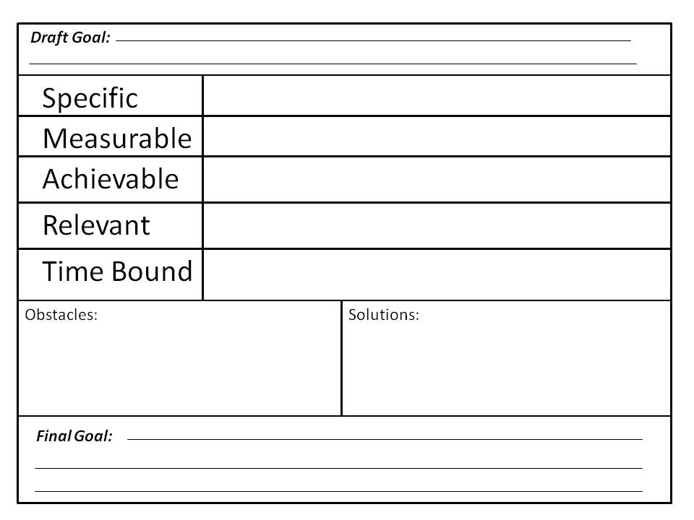

Slide 18
FAMILY
PARTNER
ART
SUPPORTS
ROOMMATE
PETS
THERAPIST
THE GYM
Notes:
Talk about other maps

Slide 19
Teach to Learn Technique
Notes:
Paul slide
Highlight benefits
Engage audience – have them jot down areas where they got stuck

Slide 20
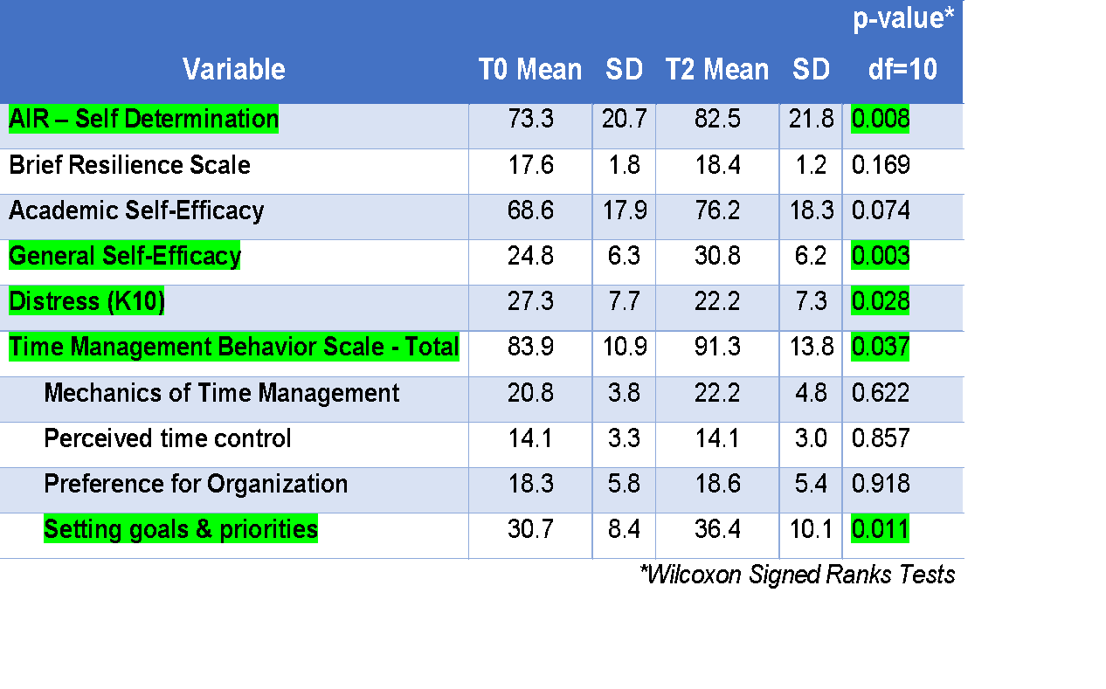
Pre and post-intervention Comparison Intermediate Targets
Notes:
“In the small open trial of the PASS model we completed during the 2017-18 academic year at BU, students showed significant improvement in their self-determination skills, general self-efficacy, psychological distress levels, and time management skills (specifically setting goals and priorities) from when they started to program to the end of the academic year.”

Slide 21
References
Newman, L., Wagner, M., Knokey, A.-M., Marder, C., Nagle, K., Shaver, D., Wei, X., with Cameto, R., Contreras, E., Ferguson, K., Greene, S., and Schwarting, M. (2011). The Post-High School Outcomes of Young Adults with Disabilities up to 8 Years After High School. A Report From the National Longitudinal Transition Study-2 (NLTS2) (NCSER 2011-3005). Menlo Park, CA: SRI International. Available at www.nlts2.org/reports/
Salzer MS, Wick LC, & Rogers JA. (2008) Familiarity with and use of accommodations and supports among postsecondary students with mental illnesses. Psychiatric Services; 59(4):370-375.
Borjas, G.J. 2013. Labor Economics. New York, NY: McGraw-Hill Irwin.

Slide 22
Questions & Connect With Us!
Paul Cherchia, LMHC
Boston University Center for Psychiatric Rehabilitation
Cherchia@bu.edu
Avery Ofoje, Peer Academic Coach
ofojea@bu.edu
Transitions to Adulthood Center for Research
http://www.umassmed.edu/TransitionsACR
Laura Golden – laura.golden@umassmed.edu
Maryann Davis – Maryann.Davis@umassmed.edu

