Slide 1
A Class of our Own: Supporting the Mental Health Needs of Students of Color
Kamesha Spates, Ph.D
Kent State University
Assistant Professor
Department of Sociology
October 31, 2019

Slide 2
Today’s Goals
Discuss mental illness prevalence rates of college students of color in the United States.
Identify the unique stressors faced by students of color at PWI’s.
Highlight factors to consider in supporting the mental health needs of college students of color.

Slide 3
Key Concepts
Racial Minorities¹
Predominately White Institutions (PWI’s)

Slide 4
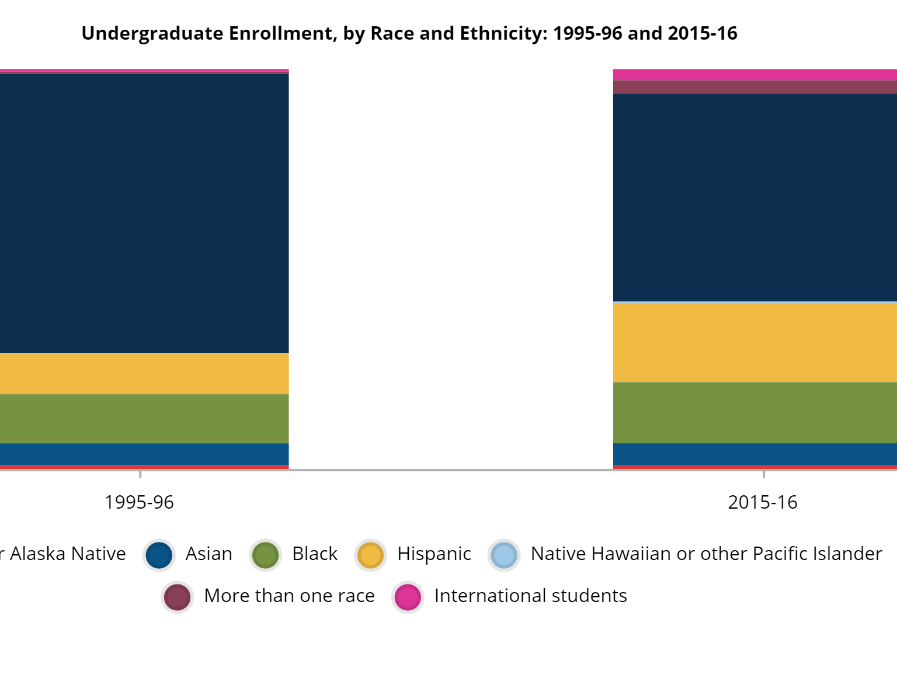
U.S. Department of Education, National Postsecondary Student Aid Study, 1996 and 2016

Slide 5
A moment of reflection
Who are the students of color on your campus?

Slide 6
Prevalence rates
This Photo by Unknown Author is licensed under CC BY-NC

Slide 7
Mental health among college students of color is an understudied topic²
Inconclusive Results:
Higher rates of depression, anxiety, and functional impairment among college students of color in comparison to whites³.
Other studies find no difference in mental illness prevalence rates⁴.
Being a member of a minority group at a PWI/U can decrease the psychological functioning of students of color⁵.

Slide 8
Increasing rates of suicide among people of color ^{6,7}
Students of color are less likely to utilize campus counseling services ⁸.
Predictors include ⁸
Greater psychological distress
Previous history of psychological distress
Less family Support
Students of color report higher levels of stress than white college students who suffer from depression or anxiety⁹.

Slide 9
A moment of reflection
What challenges might students of color on your campus face when seeking help and utilizing campus mental health resources?

Slide 10
Stressors among students of color at PWI’s

Slide 11
Lived experiences of Students of color
On-Campus
Off Campus
Society

Slide 12
Social stressors
Structural Challenges⁹
Prejudice and discrimination
More likely to come from lower SES backgrounds
More likely to be first in family (FOF)
More likely to have graduated from underperforming High Schools

Slide 13
Navigating life as a student of Color at a PWI
Acculturative Stress ¹⁰
Being a member of a minority group at a PWI/U can decrease the psychological functioning of students of color⁵
Academic Inferiority or Academic Phoniness⁵
The impact of Microaggressions on mental health and self-esteem¹¹
Perceptions of being a burden¹²
Racial Battle Fatigue¹³
AWA ¹⁴

Slide 14
Supporting the Mental Health Needs of Students of Color

Slide 15
A moment of reflection
What steps has your campus community taken to support the mental health needs of students of color?
SHARE WITH OTHERS!!!

Slide 16
Consider a Multi-Cultural Strength-Based Approach
Ethnic Identity⁵
Political Activism¹⁵
Spirituality ^{16, 17}
Parental and extended family support ¹⁷
Involvement in student organizations ¹⁷

Slide 17
Literature-based recommendations
Climate study to capture the experiences of each marginalized group members both on and off campus ^{18,19}
A mental health needs assessment⁸
Campus administrators should consider societal implications of being a racial or ethnic minority including intersecting identities ^{18,19, 20}
Foster a sense of belonging²¹

Slide 18
“Feelings of Belonging”²¹
Culturally competent staff and faculty members
Create a space for sense of belonging
Pedagogical approaches and campus programming should be culturally sensitive
Establish a multi-dimensional system of mentorship compassion

Slide 19
Identify and promote the mental health and well-being of students of color as a campus-wide priority
Engage students to provide guidance and feedback on matters of student mental health and emotional well- being
Actively recruit, train and retain a diverse and culturally competent faculty and professional staff
Create opportunities to engage around national and international issues/events
Create dedicated roles to support well-being and success of students of color
Support and promote accessible, safe communication with campus administration and an effective response system
Offer a range of supportive programs and services in varied formats
Help students learn about programs and services by advertising and promoting through multiple channels
Identify and utilize culturally relevant and promising programs and practices, and collect data on effectiveness
Participate in resource and information sharing (within and between schools).

Slide 20
Questions?
Contact Information
Kamesha Spates, Ph.D
Kent State University
kspates1@kent.edu
Office Phone: 330-672-0314

Slide 21
References
Strmic-Pawl, H. V., Jackson, B. A., & Garner, S. (2018). Race counts: racial and ethnic data on the US census and the implications for tracking inequality. Sociology of Race and Ethnicity, 4(1), 1-13.
Lipson, S. K., Kern, A., Eisenberg, D., & Breland-Noble, A. M. (2018). Mental health disparities among college students of color. Journal of Adolescent Health, 63(3), 348-356.
Eisenberg, D., Hunt, J., & Speer, N. (2013). Mental health in American colleges and universities: variation across student subgroups and across campuses. The Journal of nervous and mental disease, 201(1), 60-67.
Herman, S., Archambeau, O. G., Deliramich, A. N., Kim, B. S., Chiu, P. H., & Frueh, B. C. (2011). Depressive symptoms and mental health treatment in an ethnoracially diverse college student sample. Journal of American College Health, 59(8), 715-720.
McClain, S., Beasley, S. T., Jones, B., Awosogba, O., Jackson, S., & Cokley, K. (2016). An examination of the impact of racial and ethnic identity, impostor feelings, and minority status stress on the mental health of Black college students. Journal of Multicultural Counseling and Development, 44(2), 101-117.

Slide 22
References
Bridge, J. A., Asti, L., Horowitz, L. M., Greenhouse, J. B., Fontanella, C. A., Sheftall, A. H., ... & Campo, J. V. (2015). Suicide trends among elementary school–aged children in the United States from 1993 to 2012. JAMA pediatrics, 169(7), 673-677.
O Odafe, M., C Talavera, D., Cheref, S., H Hong, J., & L Walker, R. (2016). Suicide in racial and ethnic minority adults: A review of the last decade. Current Psychiatry Reviews, 12(2), 181-198.
Hayes, J. A., Youn, S. J., Castonguay, L. G., Locke, B. D., McAleavey, A. A., & Nordberg, S. (2011). Rates and predictors of counseling center use among college students of color. Journal of College Counseling, 14(2), 105-116.
Turner, F. D., & Smith, J. K. (2015). A comparative study on the stress levels of black, white, Asian, and Latino undergraduate students. Journal of Research Initiatives, 1(3), 6.
Smith, K. M., Chesin, M. S., & Jeglic, E. L. (2014). Minority college student mental health: Does majority status matter? Implications for college counseling services. journal of Multicultural counseling and development, 42(2), 77-92.
Griffin, Kristin Davidoff, and Julie Sriken. 2014. “The Adverse Impact of Racial Microaggressions on College Students’ Self-Esteem.” Journal of College Student Development 55(5): 461-474.
Hollingsworth, D. W., Cole, A. B., O'Keefe, V. M., Tucker, R. P., Story, C. R., & Wingate, L. R. (2017). Experiencing racial microaggressions influences suicide ideation through perceived burdensomeness in African Americans. Journal of counseling psychology, 64(1), 104.

Slide 23
References
Smith, W. A., Hung, M., & Franklin, J. D. (2011). Racial battle fatigue and the miseducation of Black men: Racial microaggressions, societal problems, and environmental stress. The Journal of Negro Education, 63-82.
Durkee, Myles I. and Joanna L. Williams. 2015. “Accusations of Acting White: Links to Black Students’ Racial Identity and Mental Health.” Journal of Black Psychology 4(1): 26-48.
Hope, E. C., Velez, G., Offidani-Bertrand, C., Keels, M., & Durkee, M. I. (2018). Political activism and mental health among Black and Latinx college students. Cultural Diversity and Ethnic Minority Psychology, 24(1), 26.
Jones, A. C. (1993). Wade in the Water. The wisdom of the spirituals. Maryknoll, NY: Orbis Books.
Butler, S. K., Evans, M. P., Brooks, M., Williams, C. R., & Bailey, D. F. (2013). Mentoring African American men during their postsecondary and graduate school experiences: Implications for the counseling profession. Journal of Counseling & Development, 91(4), 419-427.
Nadal, K. L., Wong, Y., Griffin, K. E., Davidoff, K., & Sriken, J. (2014). The adverse impact of racial microaggressions on college students' self-esteem. Journal of college student development, 55(5), 461-474.
West, L. M., Donovan, R. A., & Daniel, A. R. (2016). The price of strength: Black college women’s perspectives on the strong Black woman stereotype. Women & Therapy, 39(3-4), 390-412.
Jones, S. R., Kim, Y. C., & Skendall, K. C. (2012). (Re-) framing authenticity: Considering multiple social identities using autoethnographic and intersectional approaches. The Journal of Higher Education, 83(5), 698-724.
Hunn, Vanessa. "African American students, retention, and team-based learning: A review of the literature and recommendations for retention at predominately white institutions." Journal of Black Studies 45, no. 4 (2014): 301-314.

